Slide 1




Lab Loading Recommendations

Slide 2
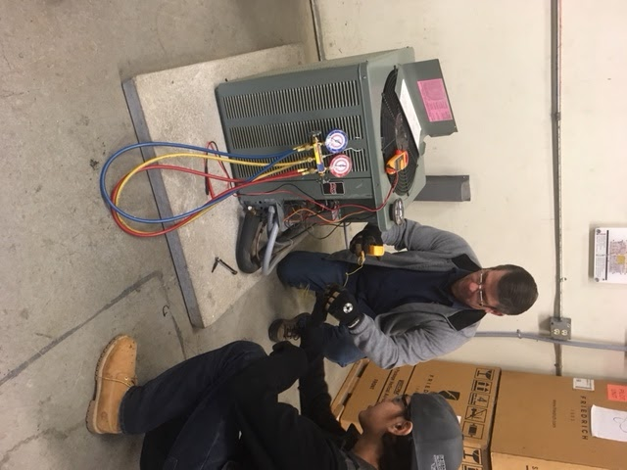
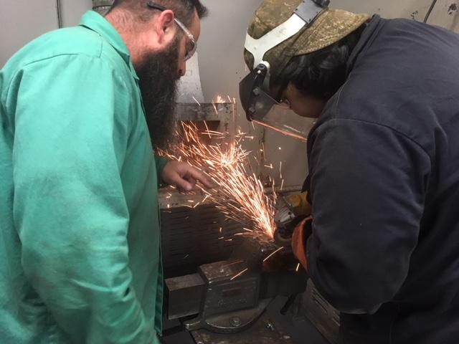
LAB LOADING
Notes:
In March 2016, faculty at St. Philip’s College expressed concerns regarding lab loading. The SPC Faculty Senate brought this concern to the United Faculty Senate, who considered the issue and submitted a work proposal to the Executive Faculty Council (EFC) in Fall 2017. The EFC submitted its initial Recommendations to the PVC in February 2018. The PVC asked the EFC to continue work on this charge

Slide 3
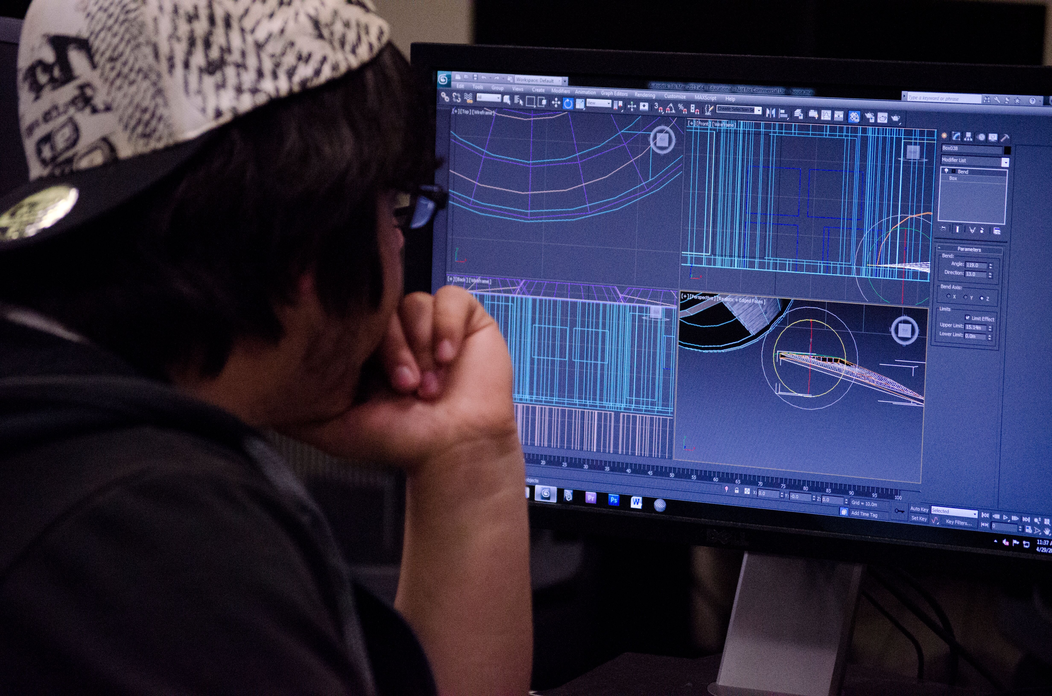
EFC Original Charge
Limit our consideration to laboratory hours as defined in Board Policy D.5.1.2 (Nursing labs were not considered for this recommendation because they are loaded as a full workload unit)
Define Instructional Laboratory and Open Laboratory
Draw comparisons with peer colleges
Use instructional loads as loaded in Banner and listed in the course catalog for cost estimating
Determine feasibility of any recommendation made

Slide 4
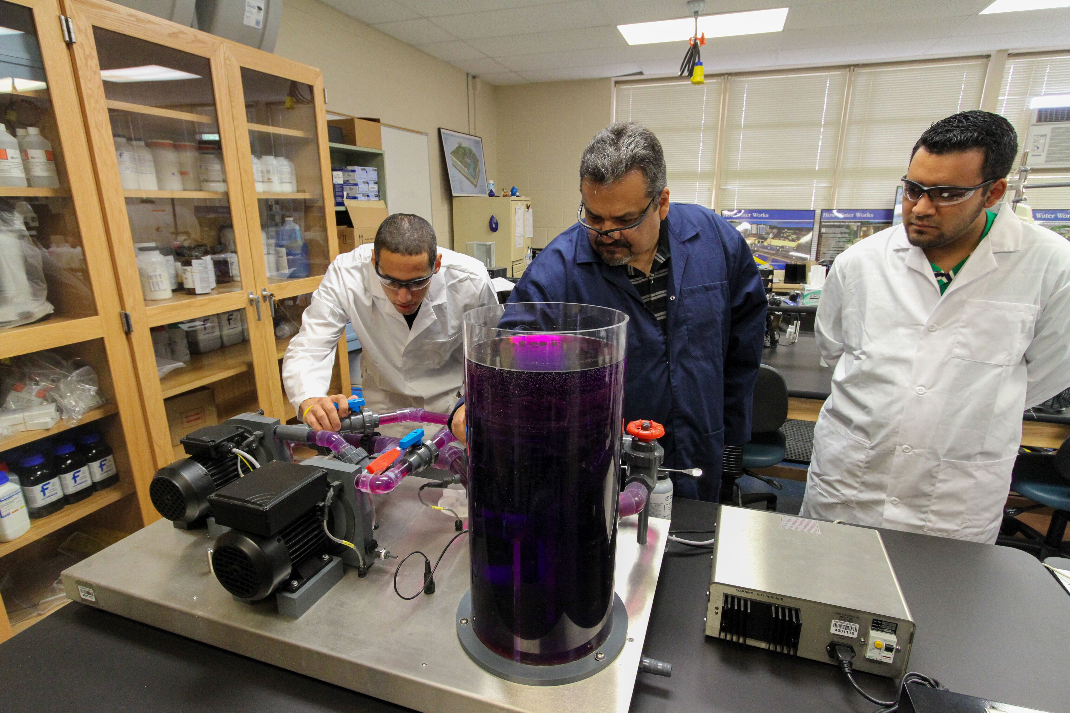
PVC Response to EFC
PVC asked the EFC to expand the existing Ad-Hoc committee to include more workforce faculty in order to find thoughtful, innovative solutions and strategies to lab loading
Notes:
Pedagogy relates to curricular issues. Curricular issues are not within this committee's scope so we did not move forward on this area of the PVC charge.

Slide 5
Recommendations
Recommendation 1 | Recommendation 2 | Recommendation 3
Increase lab loading to 1 to 1 ratio | Increase lab loading ratio to 0.85 ratio | Increase lab loading ratio to 0.75 ratio
Notes:
Time line provided by board – survey showed all institutions varied- some went 1-1 Austin went to.75 Landscape analysis was not possible due to variances ratios form college to college= committee decide this was not attainable. We combined academic and workforce ratios. WITH A COMMITMENT TO MOVE TO 1-1

Slide 6
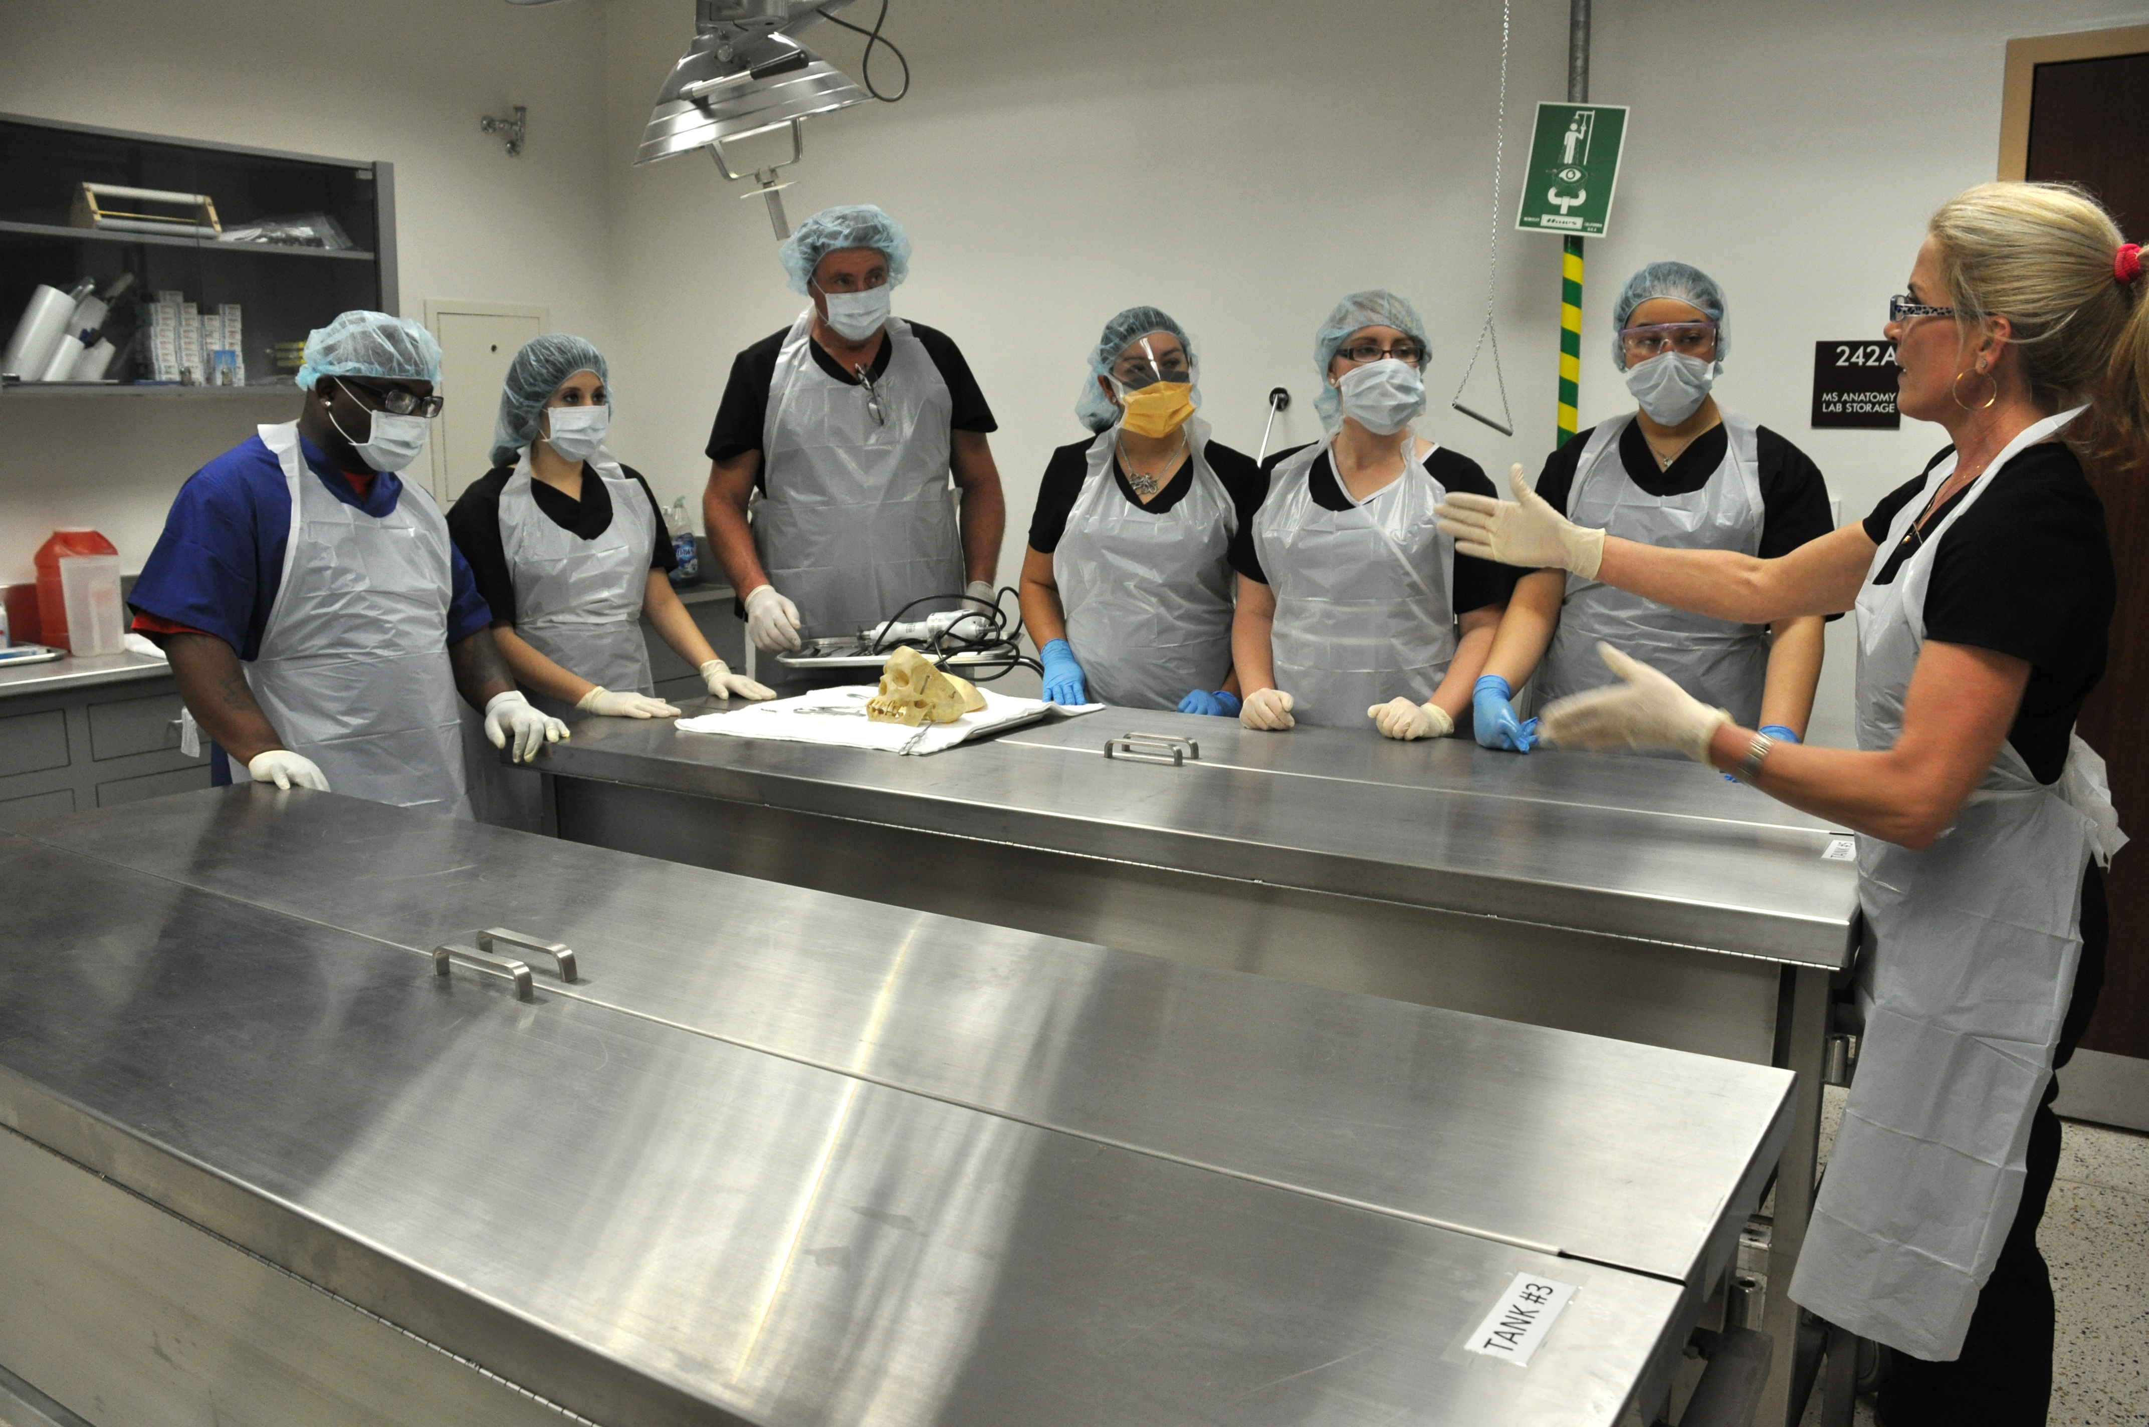
Lab-Ratio –
  Identify the number of potential faculty that will need to be hired to backfill for labs by discipline.
  Complete a landscape analysis by discipline that may impact decisions on the lab load environment.
  Describe how peer institutions within the proposal handled their lab load transition and the funding sources necessary to achieve it
Notes:
Time line provided by board – survey showed all institutions varied- some went 1-1 Austin went to.75 Landscape analysis was not possible due to variances ratios form college to college= committee decide this was not attainable. We combined academic and workforce ratios.

Slide 7
Additional Faculty to Hire
NLC 1 | NLC 1 | NLC 1
NVC 13 | NVC 11 | NVC 10
PAC 6 | PAC 5 | PAC 5
SAC 14 | SAC 12 | SAC 10
SPC 20 | SPC 17 | SPC 15
Based on 1.1 Lab Ratio | Based on .85 Lab Ratio | Based on .75 Lab Ratio
Total 54 | Total 46 | Total 41
Notes:
Source- Alamo Colleges HR =Annual Cost to Increase Lab Loading Rates with benefit expense
Calculations provided by Human Resources and verified by Faculty
Used Weighted Average of FT Faculty and Adjunct Rates based on 55% FT /45% PT
Used 31% benefit Rate for FT (55% of cost) and 9% benefit rate for PT (45% of cost) - averages to 21% benefit expense
We did not want to dictate hiring , we leave that to each college to determine.

Slide 8
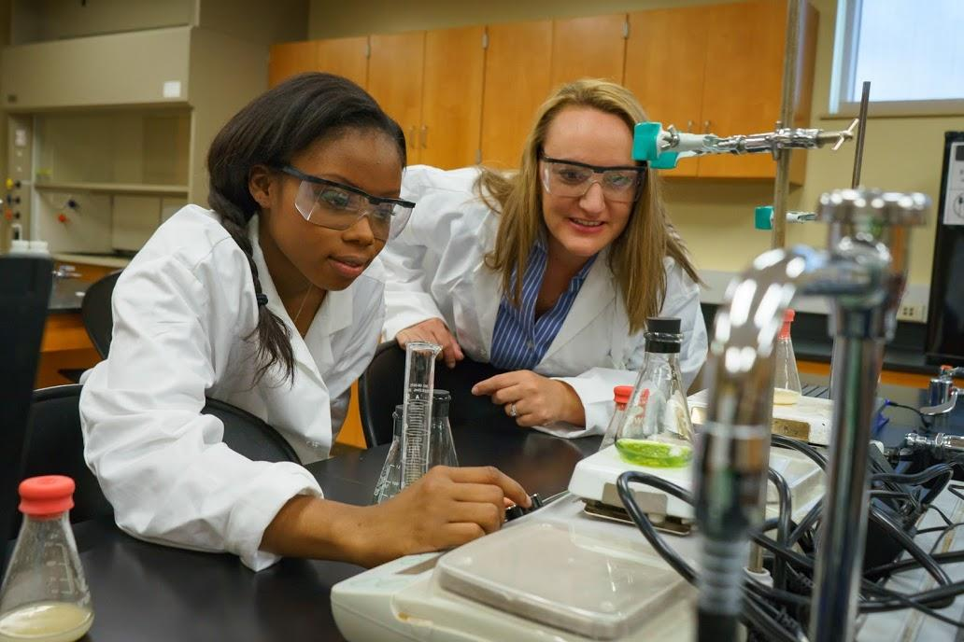
Work Load Comparisons
A biology Professor must teach 18 hours to equal the required 15 work load units
A history Professor only has to teach 15 hours to equal the required 15 work load units

Slide 9
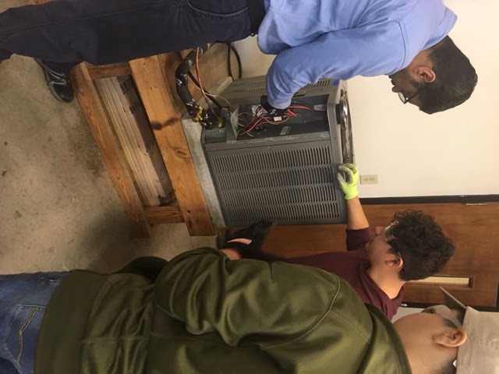
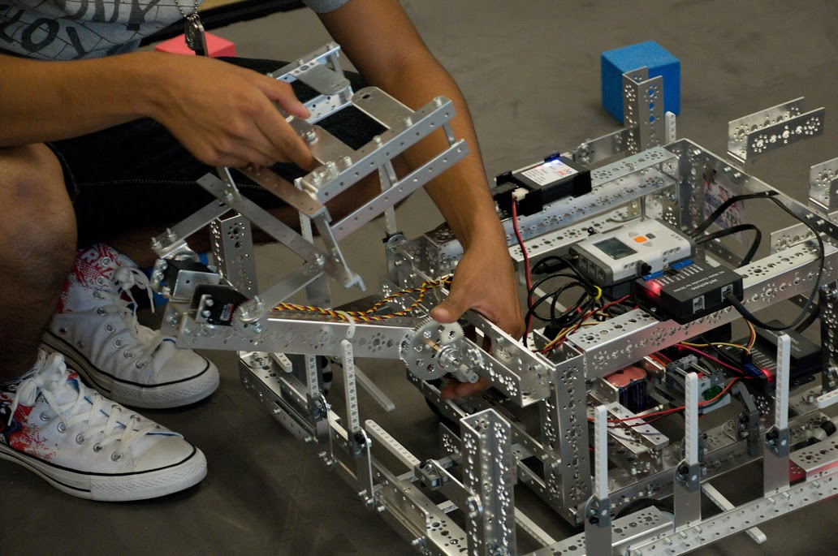

Notes:
These negative consequences of pay differential in labs impacts our ability to train for the high demand high paying jobs outlined in the SA Works initiative.
IT= Web Developers , software developers, Computer use support specialists
Manufacturing = Production supervisors and operators, mechanics and installers. Purchasing agents, byers, Electrical and electronics engineering technicians. Aircraft mechanical, industrial engineering Technicians.
SA WORK recently shared a report of the fastest growing jobs in San Antonio Health Care= LVN, Dental ……

Slide 10
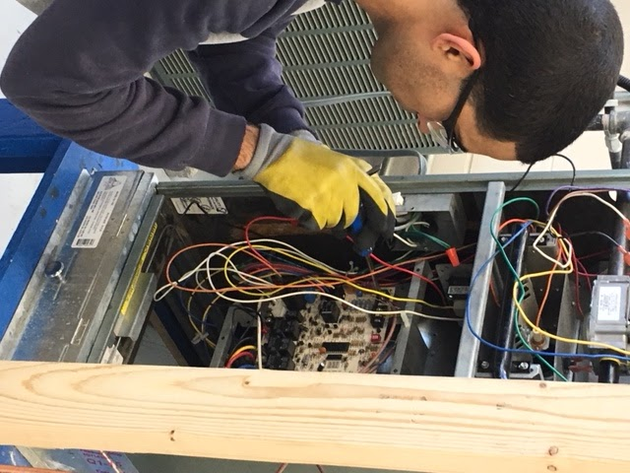
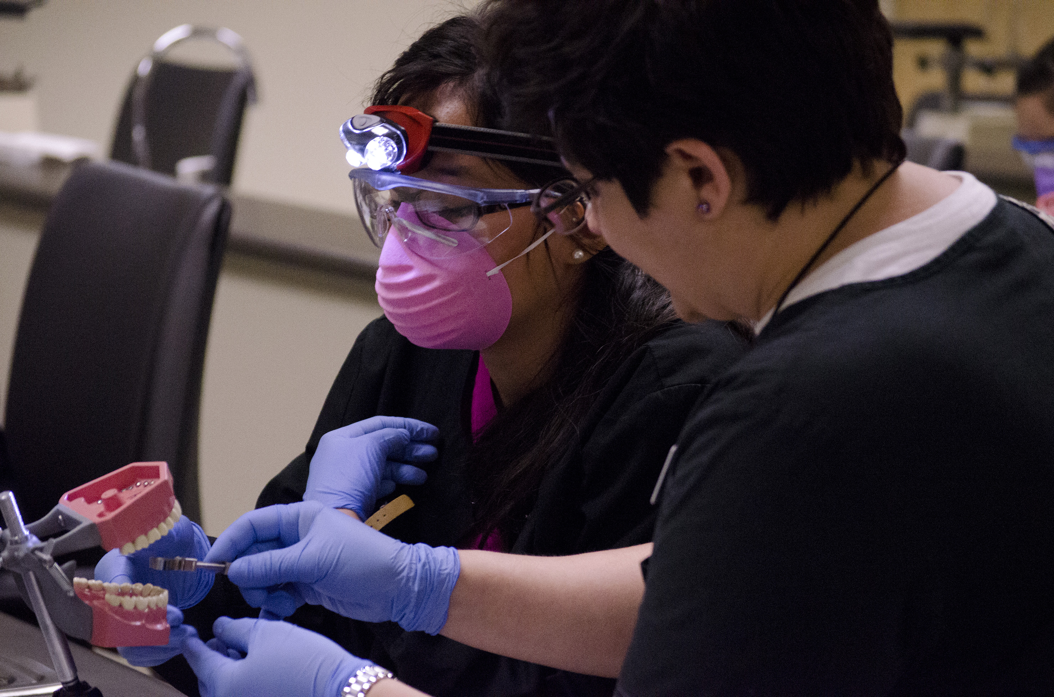
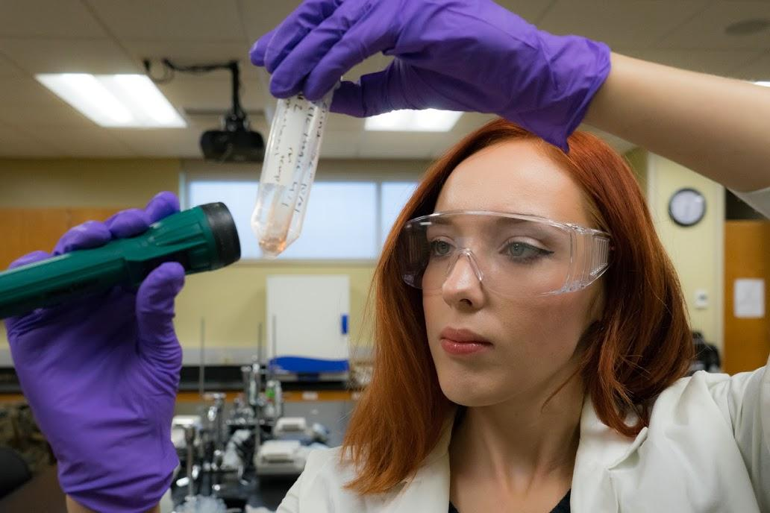
Hands
on
Experience
Notes:
Alamo Colleges offer the high wage high demand programs that lead to jobs careers that change lives. We expect and demand the highest standard of instruction from professors who teach hands on skills through experiential learning. Yet we have a pay differential.

Slide 11
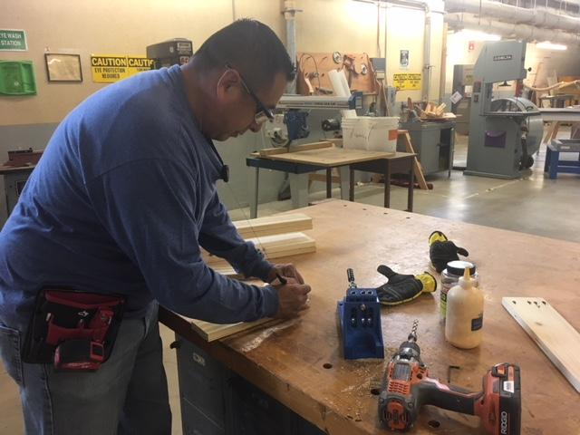
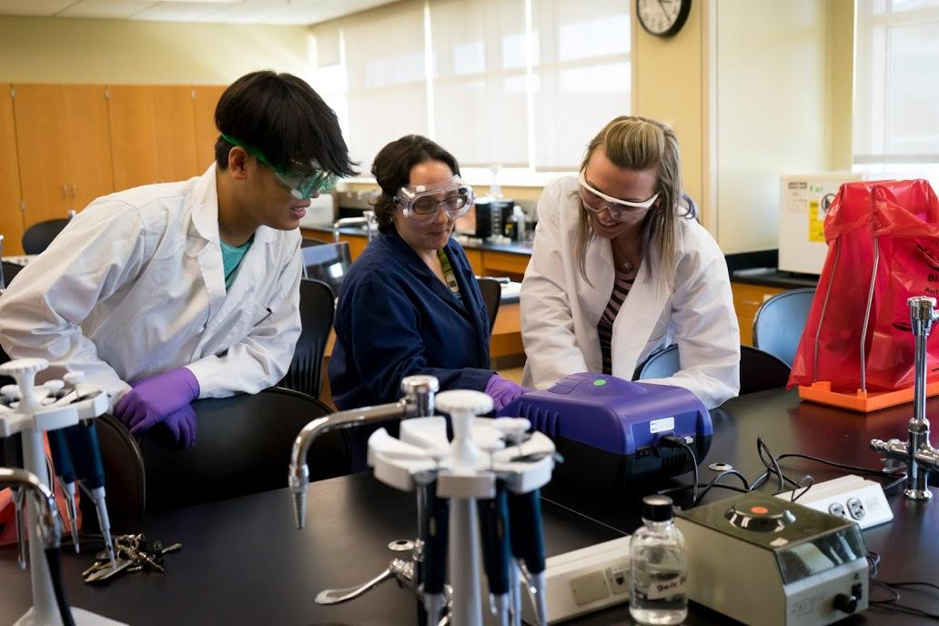
Negative Consequences of Pay Inequity
for Lab Instruction
Creates a barrier to recruitment of specialized faculty in the Sciences, Health Sciences, and Applied Sciences which are centers of high wage jobs
Hiring challenges affects the ability to offer more course sections
To meet course and program demands, lab faculty are often required to work an additional 3-9 hours per week in the lab, which hinders their ability to participate in service opportunities with students, the college, the district, and the community
Increased workload affects the ability of faculty to keep abreast of new and emerging technologies that keep curriculum fresh and cutting edge
Notes:
This is not to cry ….… it is to create awareness

Slide 12
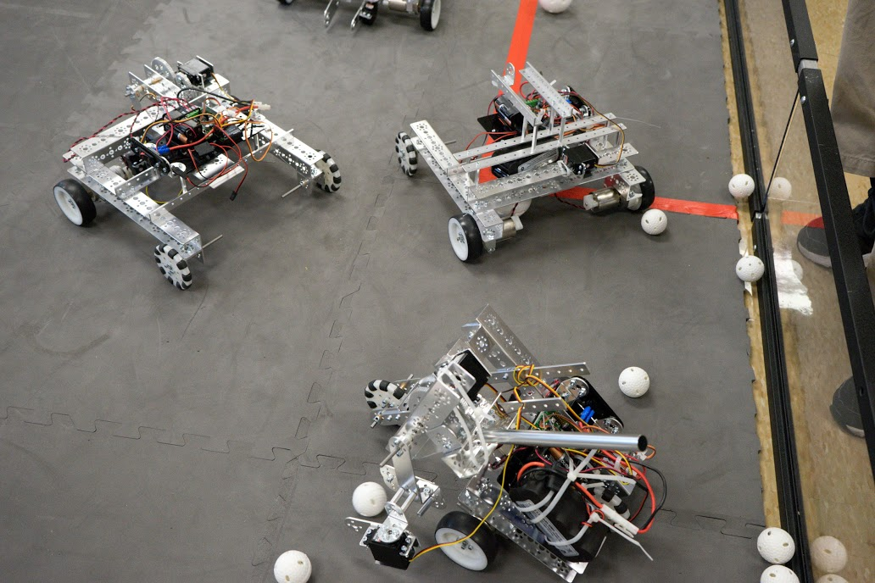
Faculty Know Funding is A Challenge…
Notes:
We would like to see the ratio for lab loading increased.

Slide 13
Texas College Systems Comparisons
College | Workload Unit for Lab
Lone Star College System | 1
San Jacinto College | 1
Tarrant County College District | 1
Houston Community College System | 1
Out-of-state Community Colleges-Median | Range of 0.80 to 0.89
Austin Community College | 0.75
ALAMO COLLEGES | 0.667
El Paso | 0.60
Notes:
We looked at both in state and out of state systems but ranges were all over the place. The out of state median was .80-.89 with a response of 12 colleges. Dallas is at .667 and tells us they have a consultant working on a new formula. Austin chose to do a flat.75 to avoid the complexities.

Slide 14
Cost of Implementation
Annual Cost to Increase Lab Loading Rates with benefit expense
Colleges | Additional Cost of Lab Loading at 0.75 | Additional Cost of Lab Loading at 0.85 | Total Cost to Reach Equity Ratio of 1 Workload Unit
NLC | $92,457.99 | $203,853.15 | $370,185.73
NVC | $442,940.09 | $976,602.86 | $1,778,869.64
PAC | $252,591.17 | $556,917.88 | $1,014,422.37
SAC | $521,387.61 | $1,149,565.44 | $2,093,926.13
SPC | $731,724.69 | $1,613,320.71 | $2,938,652.76
Total | $2,041,101.55 | $4,500,260.04 | $8,196,056.62
Notes:
Annual Cost to Increase Lab Loading Rates with benefit expense
Calculations provided by Human Resources and verified by Faculty
Used Weighted Average of FT Faculty and Adjunct Rates based on 55% FT /45% PT
Used 31% benefit Rate for FT (55% of cost) and 9% benefit rate for PT (45% of cost) - averages to 21% benefit expense

Slide 15
Recommendations
Recommendation 1 | Recommendation 2 | Recommendation 3
Increase lab loading to 1 to 1 ratio | Increase lab loading ratio to 0.85 ratio | Increase lab loading ratio to 0.75 ratio
Notes:
Time line provided by board – survey showed all institutions varied- some went 1-1 Austin went to.75 Landscape analysis was not possible due to variances ratios form college to college= committee decide this was not attainable. We combined academic and workforce ratios. WITH A COMMITMENT TO MOVE TO 1-1

Slide 16


Thank you.

