Slide 1

Northwest Vista College Community Health Advisory Board Membership 2024

Slide 2
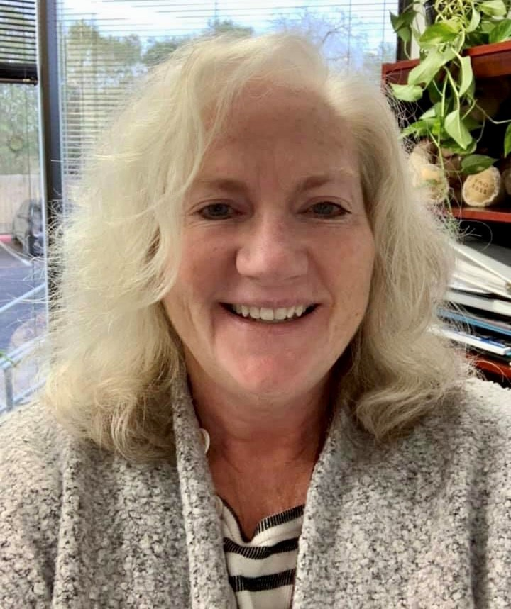
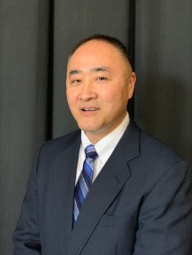

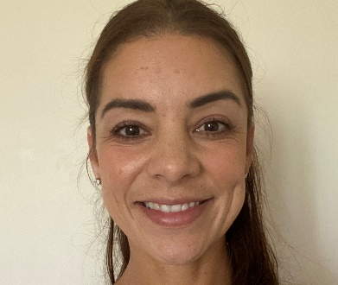
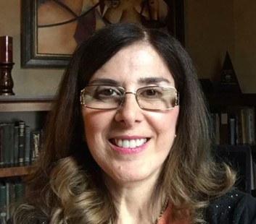
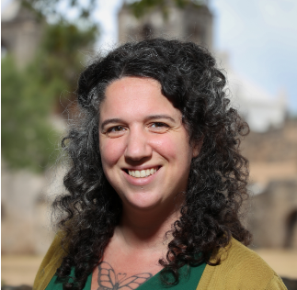
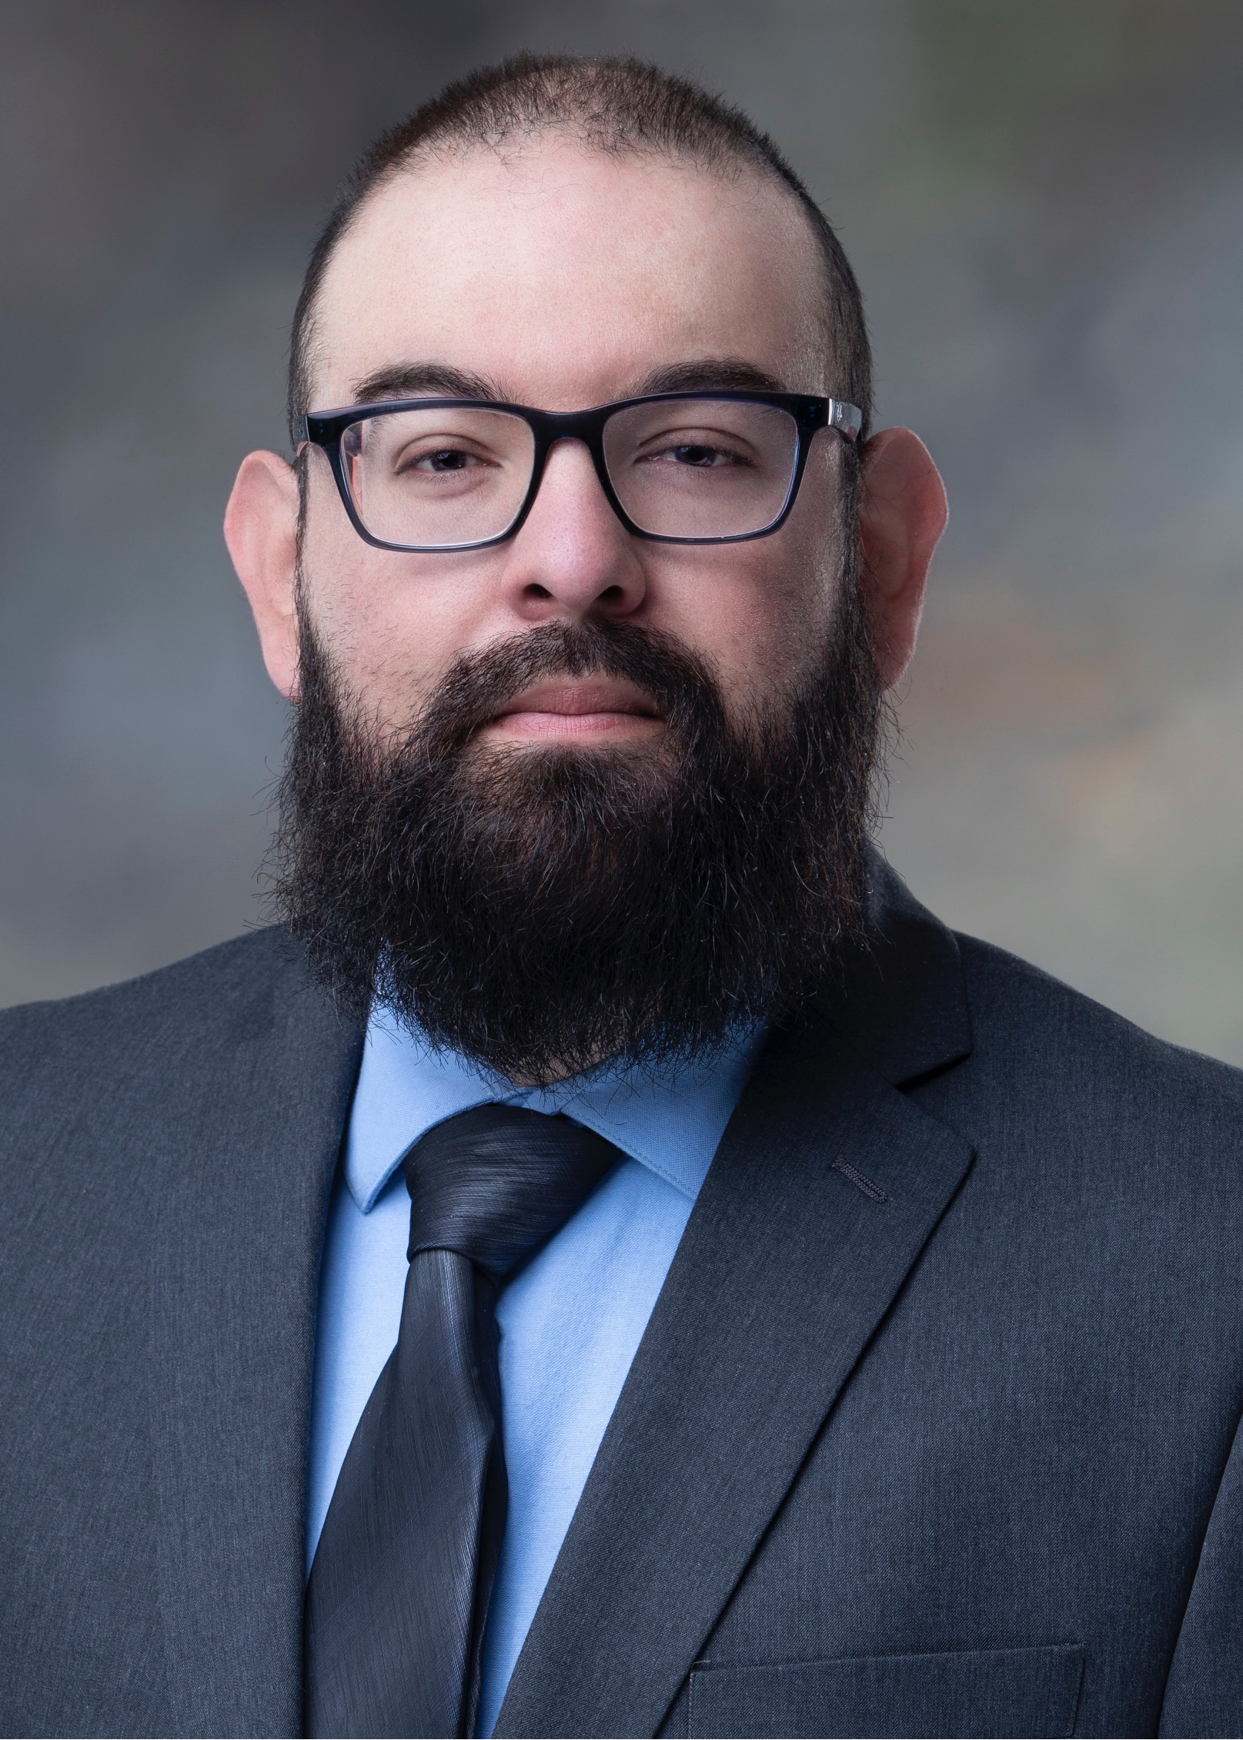
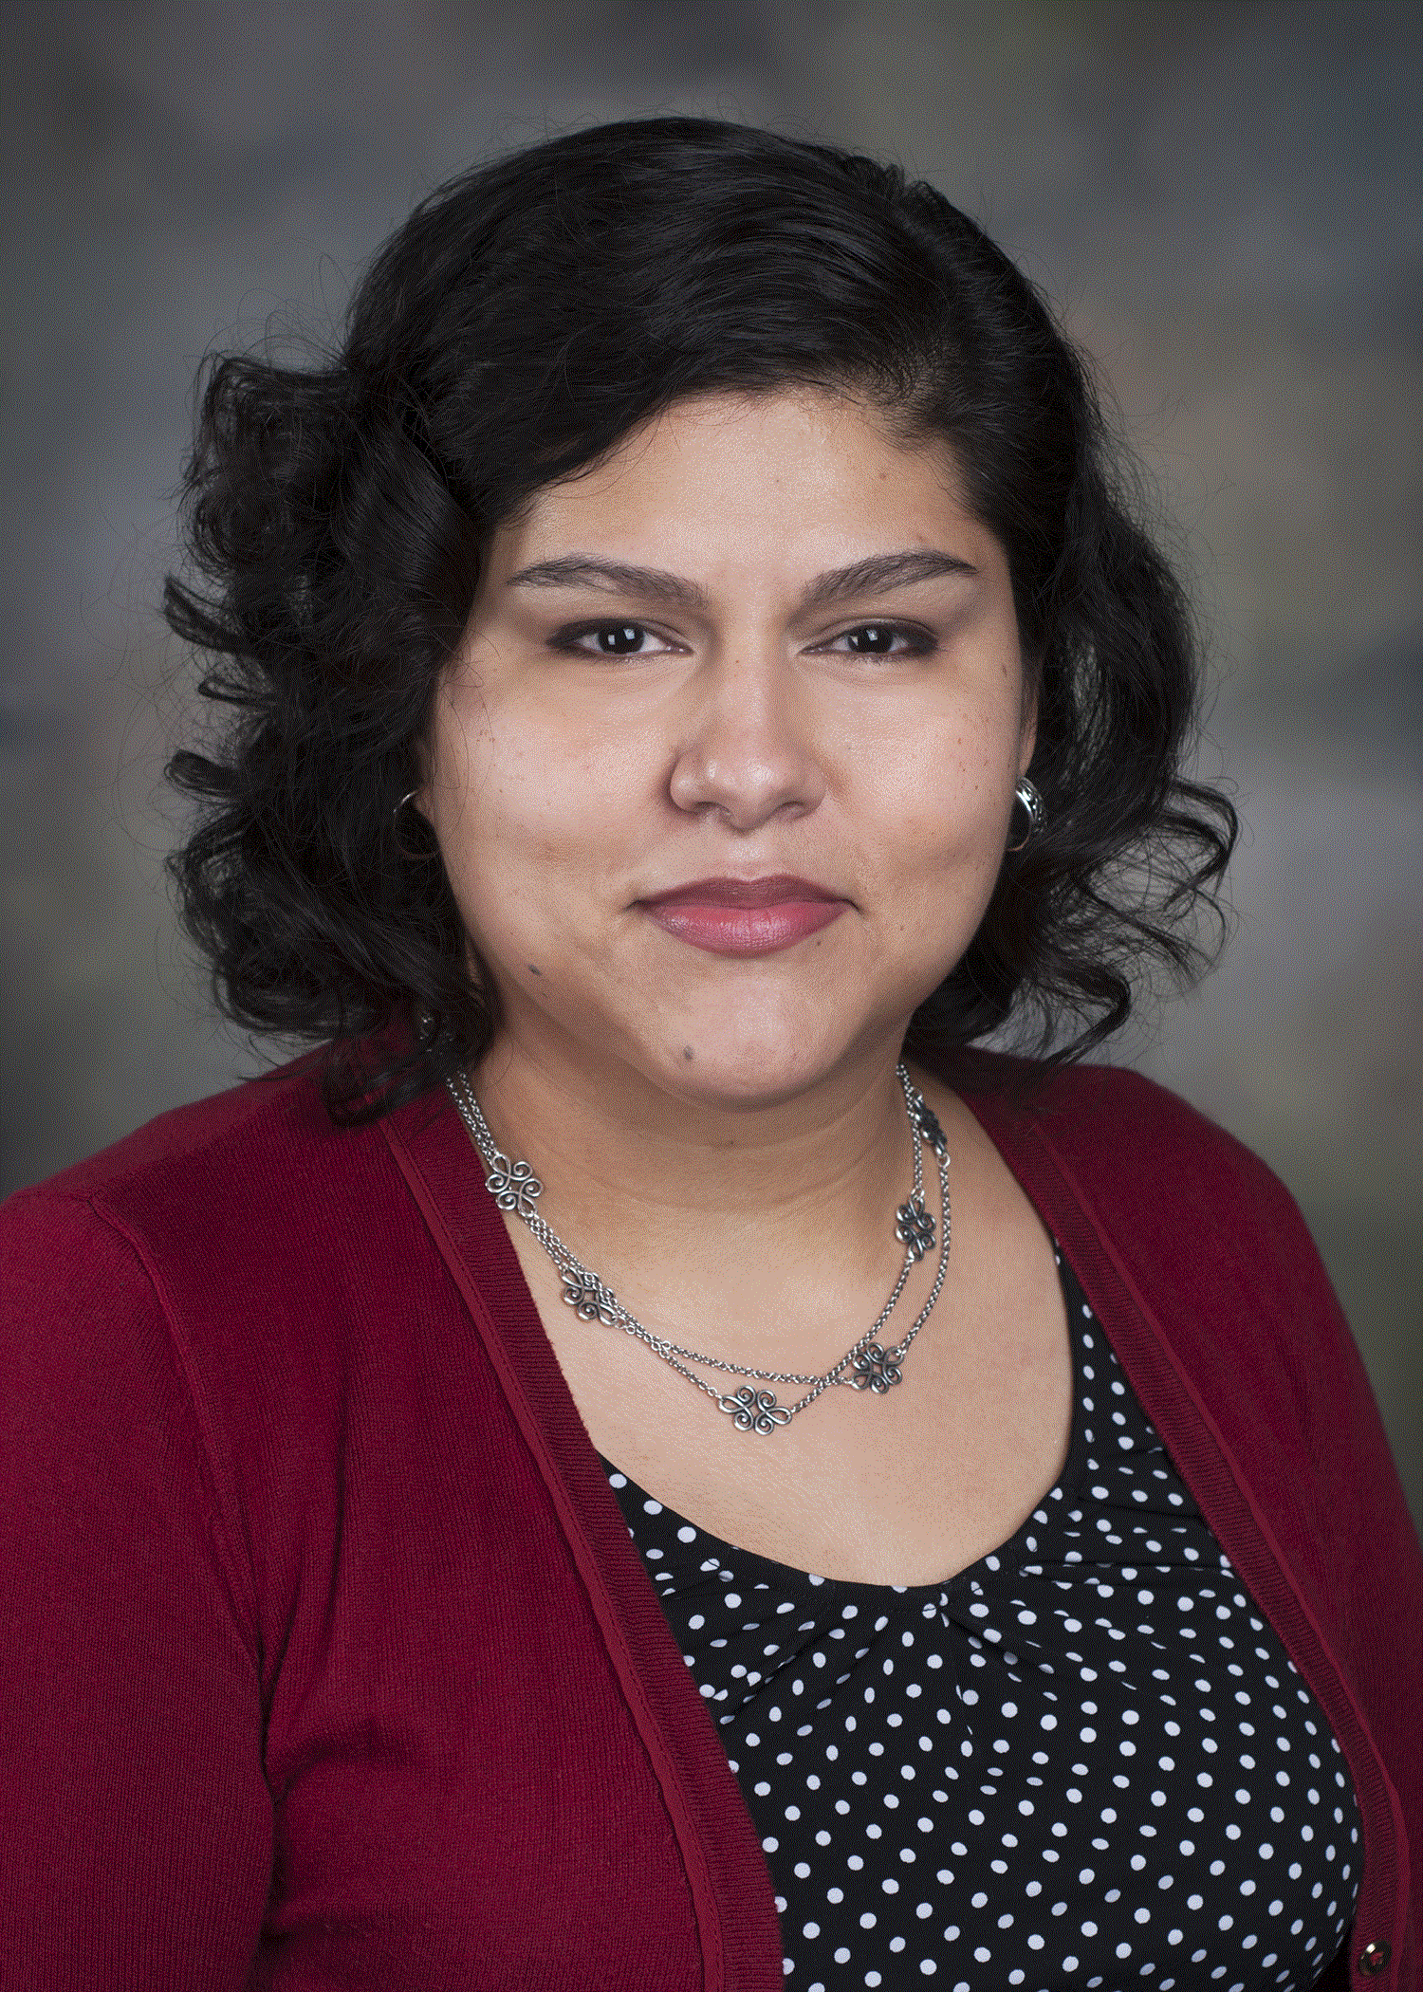
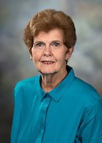
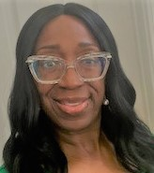
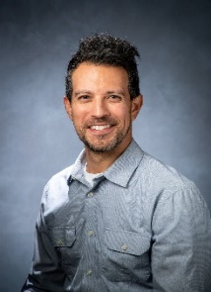
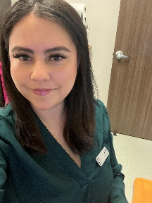
CHW ADVISORY BOARD
MEMBERS 2024
Vicki Hernandez
Verne S. Futagawa
Pegeen Seger
Faith Aguilar
Patricia Chalela
Anna Macnack
Santos Barrientes
Inez I. Cruz
Toni Tercero
Gabe Aguilar
Paula Winkler
Carla Thomas

Slide 3











CHW Advisory Board Members
Alamo Colleges Economic
Workforce Development
Vern S. Futagawa
Grant Project Director
Tonie Tercero
Patient Advocate
Planned Parenthood of South Texas
Victoria Everett
Program Coordinator/Quality Assurance
UT Health, School
Of Public Health
Inez I Cruz
Assistant Professor
UT Health San Antonio
Santos Barrientes
CHW
San Antonio Community
Pegeen Seger
UT Health, Retired

