Slide 1










Presented Fall 2023

Slide 2






An opportunity for graduating high school seniors from participating high schools who are graduating during the current academic school year to attend college tuition free.

Slide 3



What Does A Successful
College Student Look Like?
We are here to help you through college – from enrollment to graduation – to achieve your goals.

Slide 4




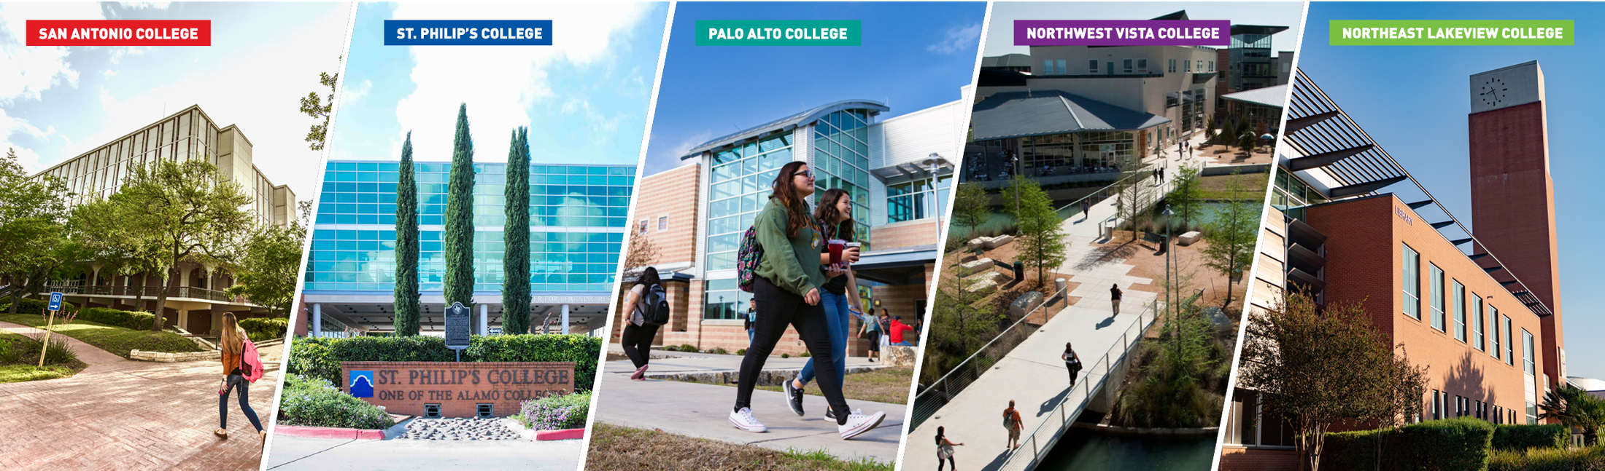
Your Passion Starts at the Alamo Colleges
5 Alamo Colleges: San Antonio College, St. Philip’s College, Palo Alto College, Northwest Vista College and Northeast Lakeview College
300+ programs to choose from including high-wage, high-demand
fields like healthcare, IT, and more
6 AlamoINSTITUTES align with your high school endorsements and interests
Notes:
Silva

Slide 5


Tuition-free College: Last-dollar Funding
AlamoPROMISE is a “last-dollar funding” program that considers first federal and state financial aid awards that a student is eligible for, such as a Pell Grant. The amount of “last-dollar” AlamoPROMISE funding each student receives will vary based on individual financial aid awards for which the student is eligible.
After the financial aid award has been applied, AlamoPROMISE provides high school graduates meeting eligibility criteria last-dollar funding to cover the remaining costs of tuition and required fees for up to three years or the completion of an associate's degree or certificate, whichever comes first.
AlamoPROMISE covers tuition including special tuition and required fees. (Student Instructional Materials (including rental textbooks), Student Support Service, Student Activity, Campus Access, and International Education)
AlamoPROMISE only covers courses that are part of a Course Program of Study (CPOS).

Slide 6
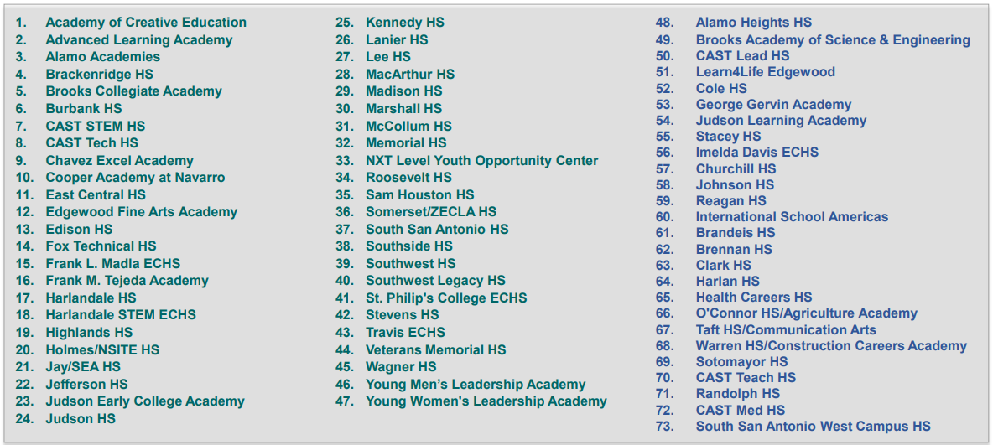
Open to Graduating Seniors at Participating High Schools
*Beginning fall of 2023 high school seniors from charter, private, and home schools in Bexar County are now eligible for AlamoPROMISE!

Slide 7

How to become a Promise Scholar
Visit alamo.edu/promise for important dates and deadlines
1: Apply to an Alamo Colleges District College
Submit your application for admission through ApplyTexas to any of our five colleges in the Alamo Colleges District. Visit goapplytexas.org.
2: Complete your financial aid application through FAFSA or TASFA
Visit fafsa.gov or access the TASFA at alamo.edu/admission--aid/paying-for-college. Complete any requirements needed to issue your financial aid award.
3: Enroll in classes for fall
Complete your enrollment steps, attend New Student Orientation, and register for classes the fall after your graduate.
Notes:
Update QR code

Slide 8





Questions?
Visit: www.alamo.edu/promise
Email: promise@alamo.edu
Contact your Enrollment Coach!
[College Connection Contact Info
Name
Email
Phone Number]

