Slide 1


Capital Improvement Program
Citizen Bond Oversight Committee
Update
June 22, 2020

Slide 2
Agenda
Welcome and Introductions
Review and Approve 02/24/2020 Meeting Minutes
CIP Construction Program
  Overview, Mr. Lacy Hampton, Interim Assoc. Vice Chancellor of G.O. Bond CIP
  SPC – Dr. Adena W. Loston, President
  SAC – Dr. Robert Vela, President
  NVC – Dr. Ric Baser, President
  PAC – Dr. Robert Garza, President
  NLC – Dr. Veronica Garcia, President
  ETC – Mr. Xavier Urrutia, Interim Vice Chancellor of Economic Workforce and Development
  CIP Technology Bond Overview
    Dr. Tom Cleary, Vice Chancellor of Planning Performance and Information Systems
  Report on Construction Manager’s SMWVBE Subcontracting Plans
Schedule Next Meeting and Closing Comments

Slide 3
CIP Construction Program

Slide 4
CIP Funding Breakdown
COLLEGE | GENERAL OBLIGATION BONDS
Northeast Lakeview College | $42M
Northwest Vista College | $69M
Palo Alto College | $66M
San Antonio College & First Responder’s Academy | $83M
St. Philip’s College & Southwest Campus | $82M
Educational Training Centers | $69M
Safety and Security: Redundant Dispatch Center | $3M
Information Technology | $25M
Real Estate (N 281 & PAC) | $11M
TOTAL | $450M
Construction Projects

Slide 5









Areas of Investment
Growth
Student
Support
Information
Technology
Health Bioscience
STEM
Labs
Advance
Manufacturing
Finance
Expanding training and preparing for high growth demands
One-stop shop for student enrollment and support
Broadening information technology service demands
Increasing emphasis on education in high demand high growth business, science, technology, engineering and mathematics fields
Centers of Excellence

Slide 6
CIP Funding
$450M General Obligation Bond Election – Passed May 2017
  No tax rate increase necessary
  Bonds were originally planned to be sold in 3 tranches
    Fall 2017 Issued $173M; and planned Fall 2019 ($169M); Fall 2021($108M)
    Based on current cash flow projections expect to issue up to $225M of bonds in Jan.2021 and remaining amount Jan. 2022
Project Costs determined during 2016, experiencing annual cost inflation of 4.46%
In May 2019 ACD Board approved issuance of $50M in Maintenance Tax Notes (MTN) to help with renovation projects and projects’ furniture, fixture and equipment, freeing up some capacity in the G.O. bonds. On May 2020, the Board approved the “Rebalancing” of the G.O. Bonds and MTN funding for each college campus
TOTAL CIP BOND FUNDING: $500M ($450M G.O. Bonds + $50M MTN)

Slide 7

Bond Projects by the Numbers
PROJECT STATUS | COUNT
Construction Complete | 1
In Construction | 8
GMP Approved | 4
GMP Within 3 Months | 3
In Design | 8
Total | 24
Notes:
GMP within 3 month: .; 1 PAC: Nat Gym SPC Bowden 3 Auto Body NVC: 4 STEM
GMP approved 1 SAC Fletcher ETC – 2 WETC
In Design – SAC: 1 Childcare; 2 chance new bldg; 3 FRA; 4 McAllister; PAC: 5 PPI and 6 Multipurpose NLC: 7Stem NVC: 8 Cypress ETCS: 9 NWETC and 10 SETC
In Construction: SPC –THCA & Norris SAC: Garage; PPI, NVC: Welcome Center & Garage & PPI
Construction Complete: Redundant SPC SWC

Slide 8

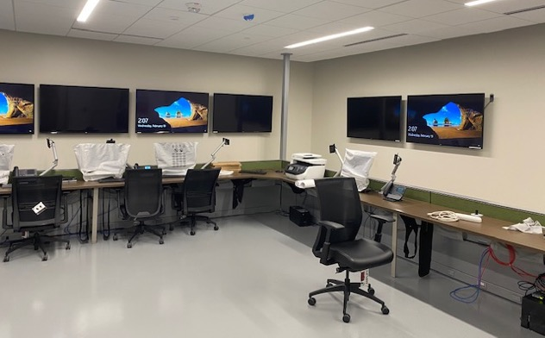
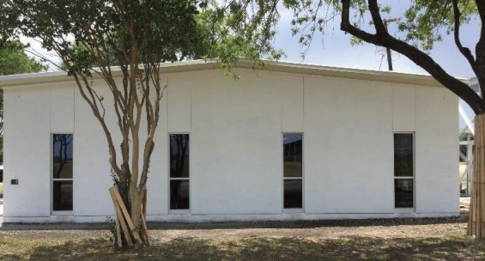
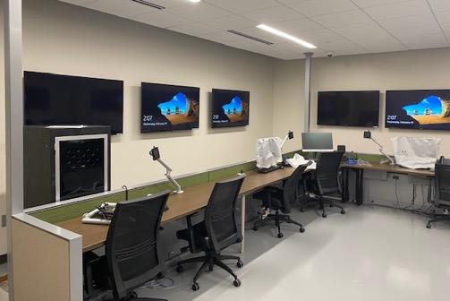
Redundant Dispatch Center
Completed Project
Type | G.O. Bond Funds | Status
New | $3 M | Completed

Slide 9
St. Philip’s College
Dr. Adena W. Loston, President

Slide 10
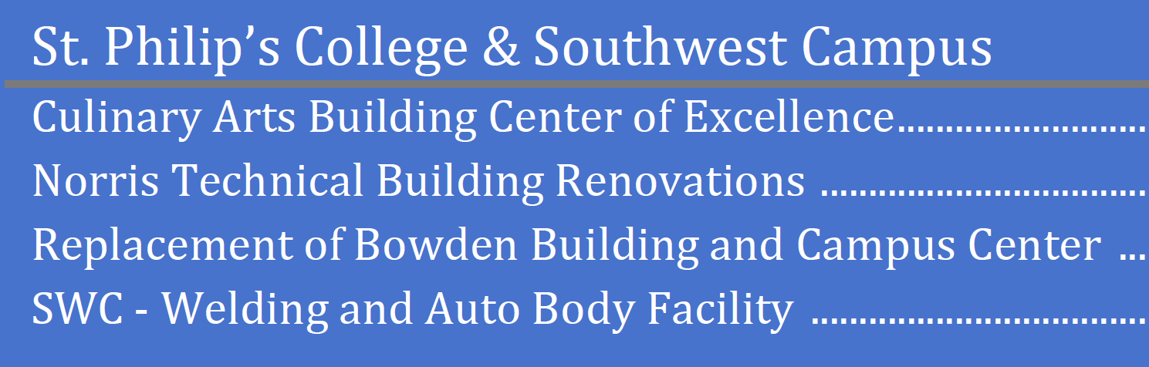
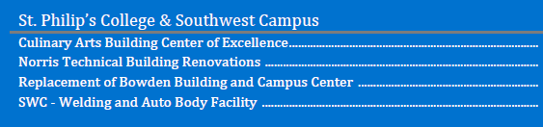
G.O. Bonds $82 Million
Maintenance Tax Note $10.99 Million (primarily Norris Renovation)

Slide 11
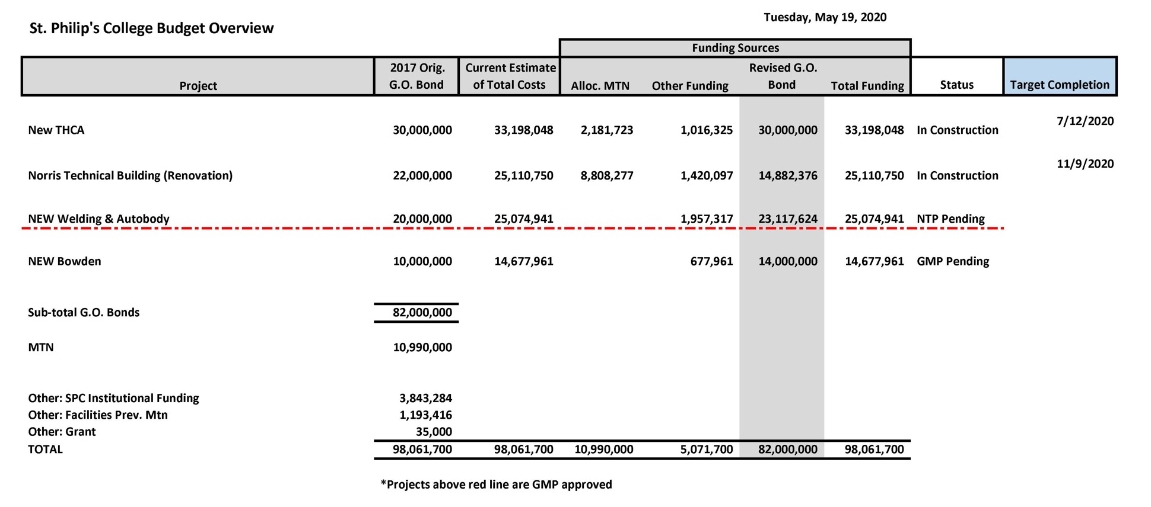
SPC Updated Budget Targets With MTN Impact
08/11/2020
NTP Issued

Slide 12
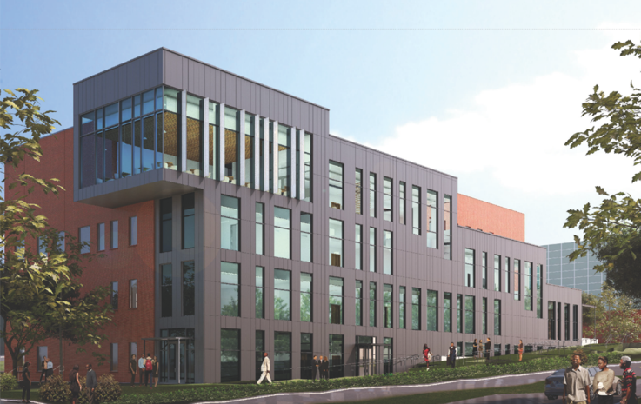
List of Projects
In Construction (2)
Approaching Substantial Completion
Tourism, Hospitality, and Culinary Arts (THCA)
In Construction: Norris Tech. Building Renov.
GMP Approved (2)
Welding and Auto Body Facility March 2020
Bowden Building (NTP Issued) May 2020
St. Philip’s College – Tourism, Hospitality, and Culinary Arts (THCA)
College Campus | Orig. GO Bond | Allocation Of MTN | Other Funding | Revised GO Bond Plan | Total
SPC | $82M | $10.99M | $5.07M | $82M | $98.06M

Slide 13
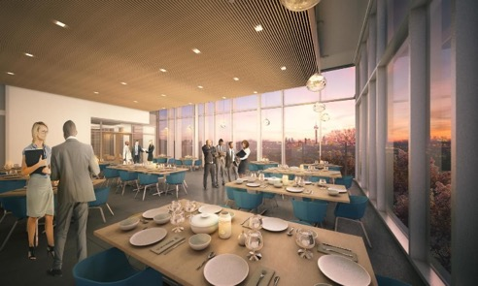

SPC – Tourism, Hospitality, and Culinary Arts (THCA)
SUBSTANTIAL COMPLETION
Project Statistics:
Architect: Page
CMAR: Skanska USA Building, Inc.
GMP: $28,200,000
GMP Approved: 12.11.18
Building Square Footage: 62,128 sf (4 stories)
Classrooms: 7 Classrooms. Labs: 5 Teaching Kitchen Labs, 2 Full Commercial Projection Kitchen Labs
Special Purpose Areas: 100 Seat Tiered Lecture Hall, Hospitality Area (Mock Hotel Space), 2 Public Restaurants
Construction Start: February 2019
Target Completion: August 2020
Academic Term Opening: Fall 2020
CMAR SMWVBE % Committed: 25%
Construction % Complete: 90%
G.O. BONDS | OTHER FUNDS | MAINTENANCE TAX NOTES | TOTAL FUNDING | EXPENSES THROUGH 6/18/20 | ESTIMATE TO COMPLETE
$30M | $1.02M (Inst. Budget) | $2.18M | $33.2M | $28.05M | $5.15M
Notes:
ICON THEME: Growth
Tourism Hospitality and Culinary Arts
Original $30M
Rebalance $--
Other funding $1.4M
MTN $2.1M
SMWVBE: 15%

Slide 14
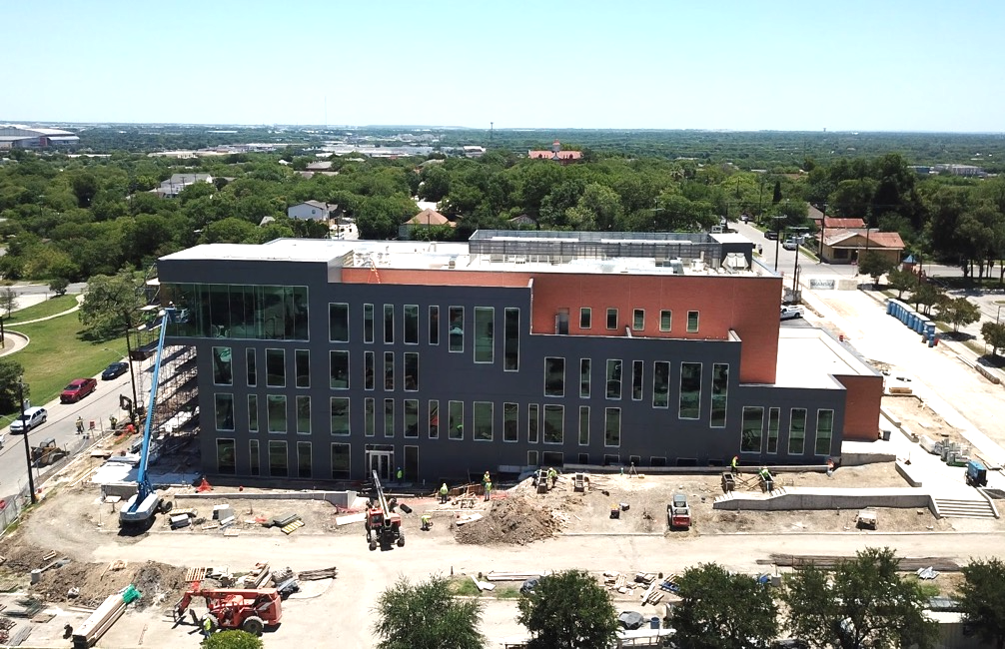
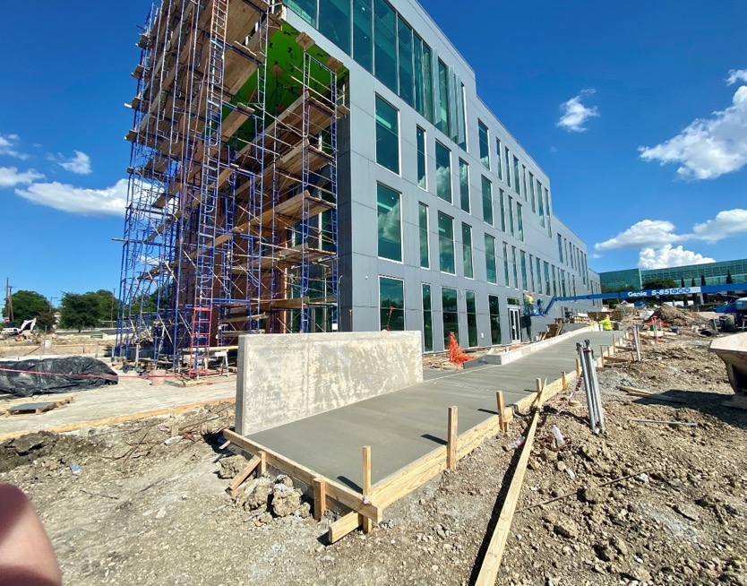
SPC – Tourism, Hospitality, and Culinary Arts (THCA)
SUBSTANTIAL COMPLETION

Slide 15
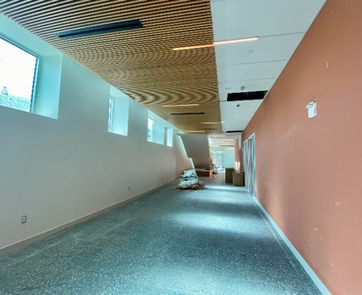
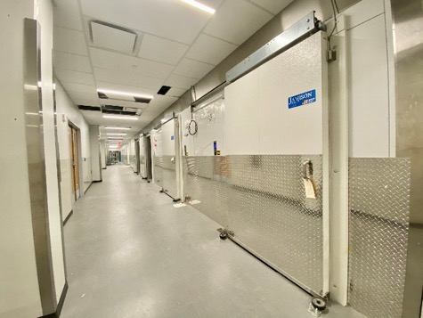
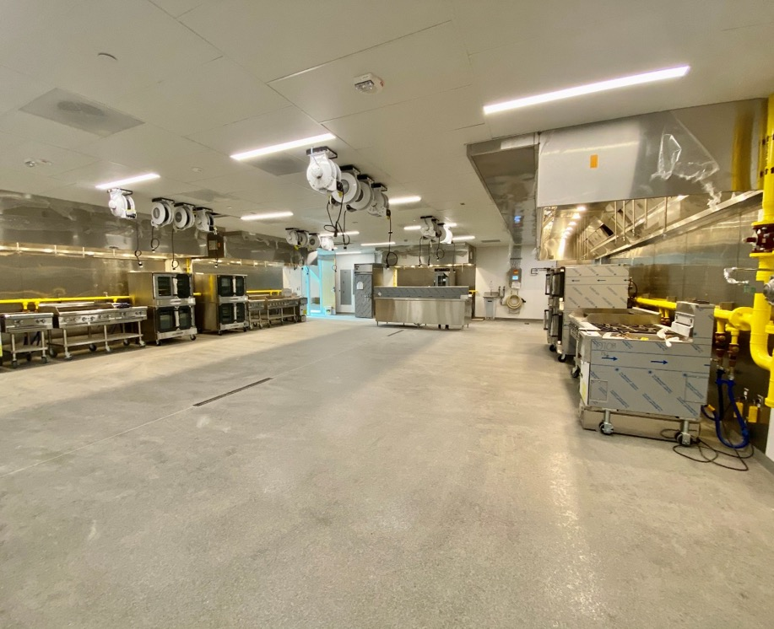
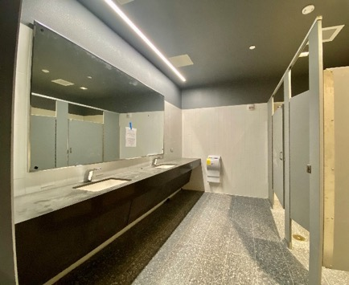
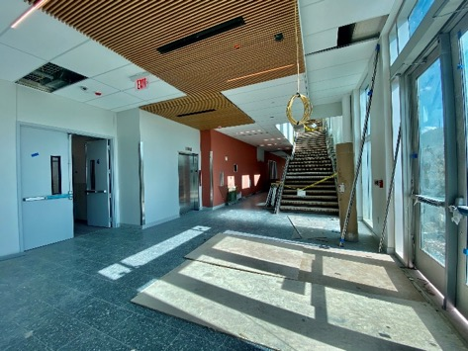
SPC – Tourism, Hospitality, and Culinary Arts (THCA)
SUBSTANTIAL COMPLETION

Slide 16
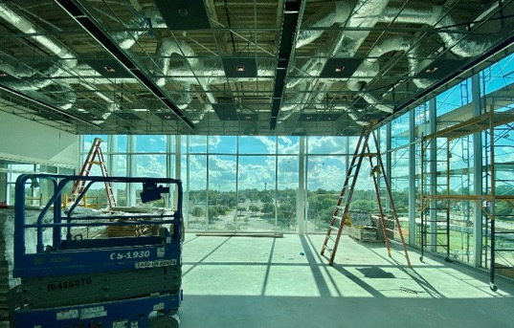
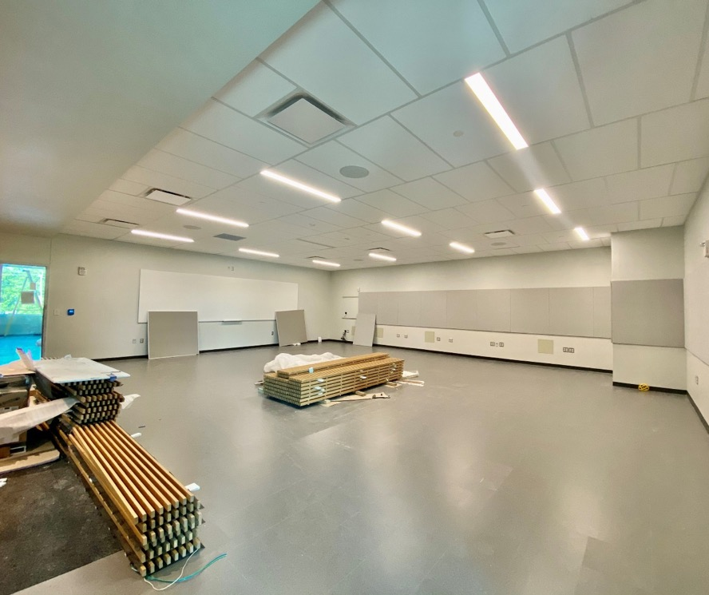
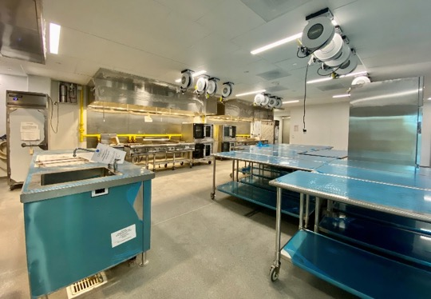
SPC – Tourism, Hospitality, and Culinary Arts (THCA)
SUBSTANTIAL COMPLETION

Slide 17
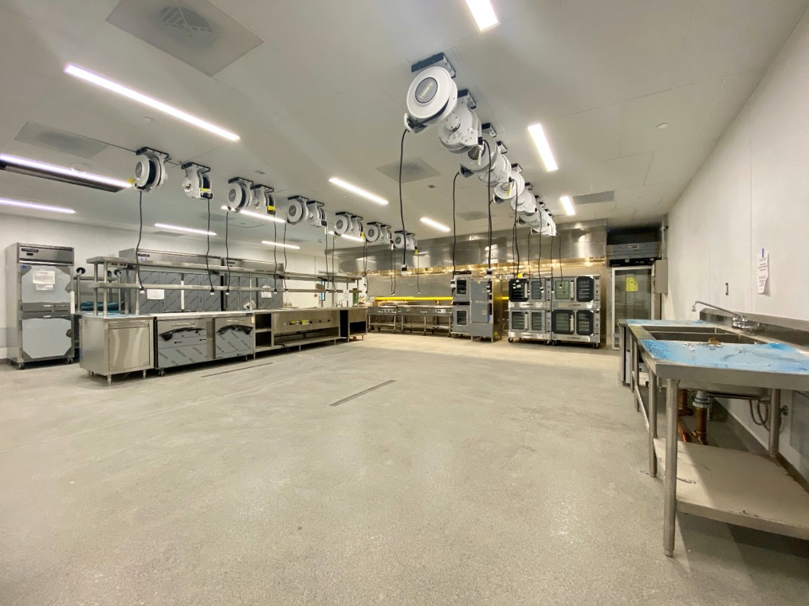
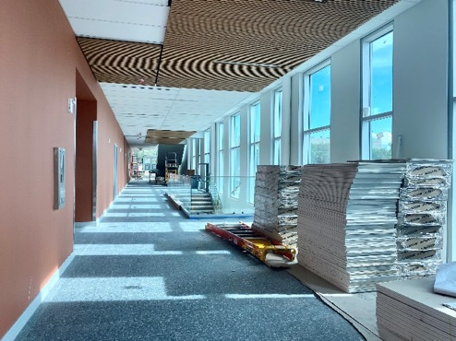
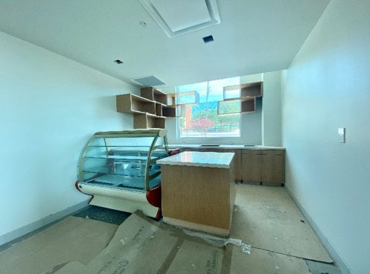
SPC – Tourism, Hospitality, and Culinary Arts (THCA)
SUBSTANTIAL COMPLETION

Slide 18
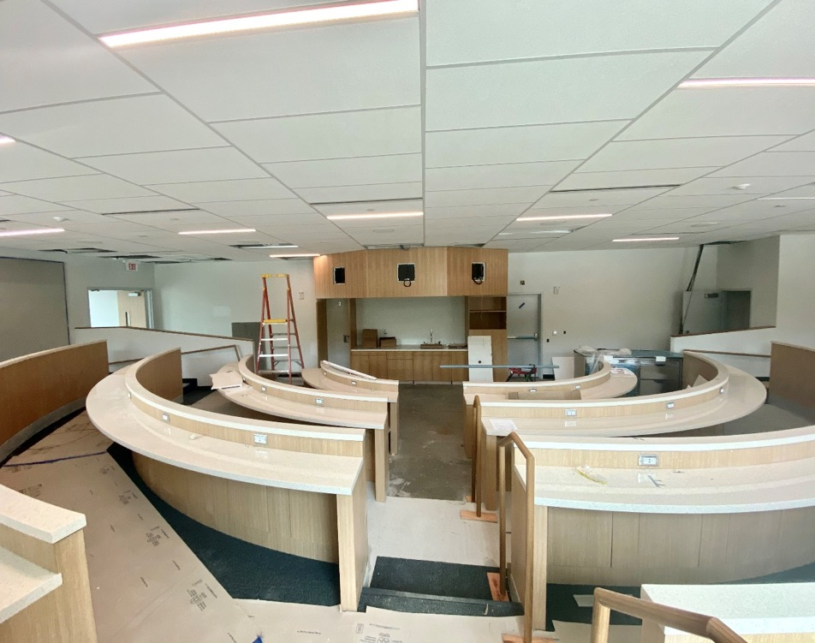
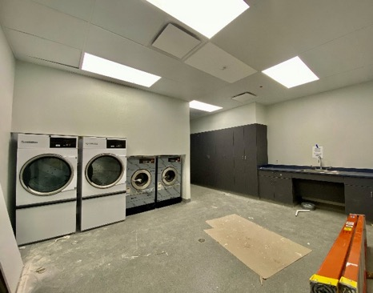
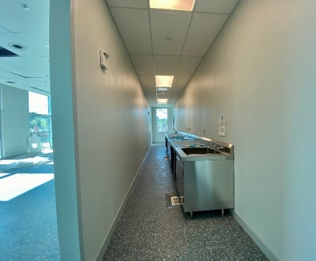
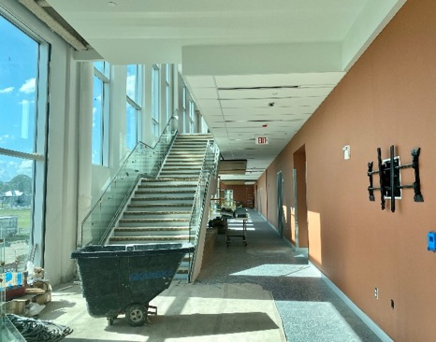
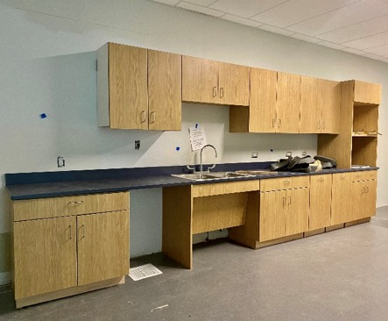
SPC – Tourism, Hospitality, and Culinary Arts (THCA)
SUBSTANTIAL COMPLETION

Slide 19
SPC – Tourism, Hospitality, and Culinary Arts (THCA)
SUBSTANTIAL COMPLETION
Time Lapse video: https://skanska.box.com/s/bxggptw82ukok7q726rclz4btorizflr
Render video: https://skanska.app.box.com/s/x6xizesettq64058e2aq03bwgw6mop6c

Slide 20
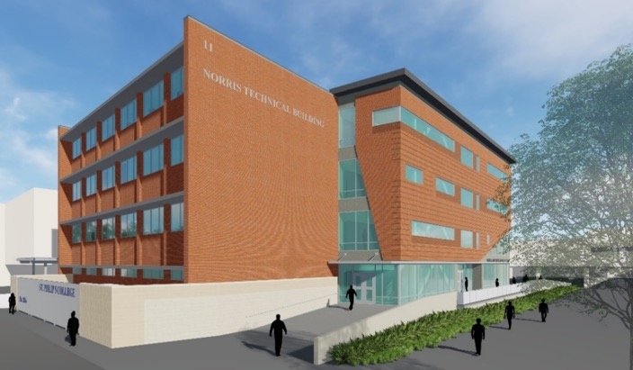


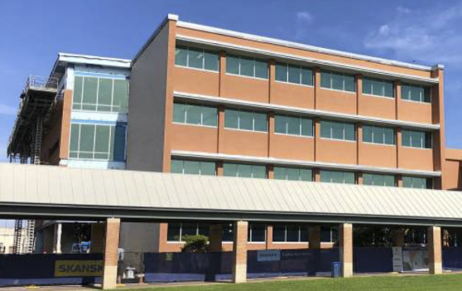
SPC – Norris Tech. Bldg. Renov.
IN CONSTRUCTION
Project Statistics:
Architect: Pfluger
CMAR: Skanska USA Building, Inc.
GMP, as Amended: $19,286,081
GMP Approved: 12.11.18, Amended on 10.22.19
Building Square Footage: 64,080 sf + 6,911sf = 70,991sf (4 stories)
Classrooms: 7 General , 10 Computer, 1 Open Lab
Labs: Tutoring & Technology Center, Rose Thomas Writing Center Special Purpose Areas: Information Technology Dept, Communications & Learning Dept, 6 Student Lounge/Study areas
Construction Start: July 2019
Target Completion: November 2020
Academic Term Opening: Spring 2021
CMAR SMWVBE % Committed: 25%
Construction % Complete: 70%
G.O. BONDS | OTHER FUNDS | MAINTENANCE TAX NOTES | TOTAL FUNDING | EXPENSES THROUGH 6/18/20 | ESTIMATE TO COMPLETE
$14.88M | $1.42 | $8.81M | $25.11M | $15.98M | $9.3M
Notes:
ICON THEME: Information Technology; Growth
Original $22M
Rebalance $15.5$
GMP amend Added $2,506,081
Original GMP amount 16,780,000 approved on 12/11/18
SMWVBE: 14.5%

Slide 21
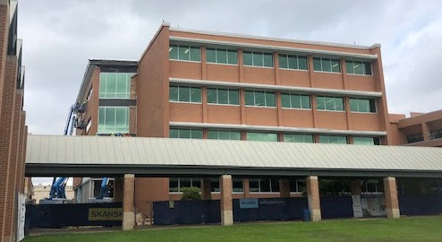
SPC – Norris Tech. Bldg. Renov.

Slide 22
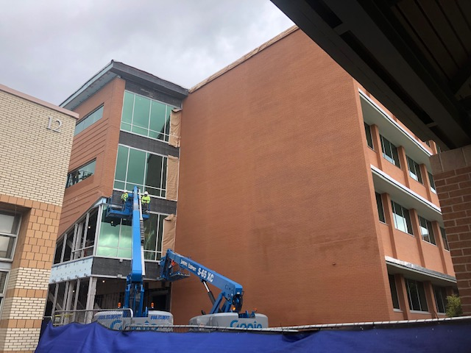
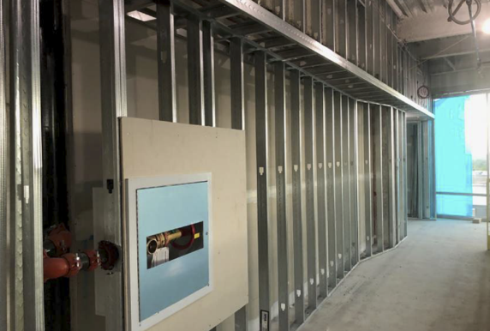
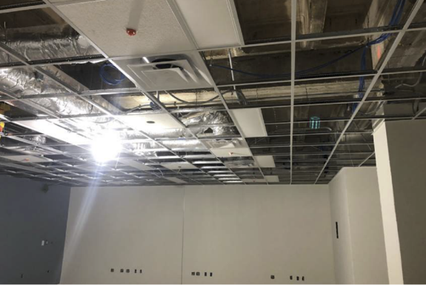
SPC – Norris Tech. Bldg. Renov.

Slide 23
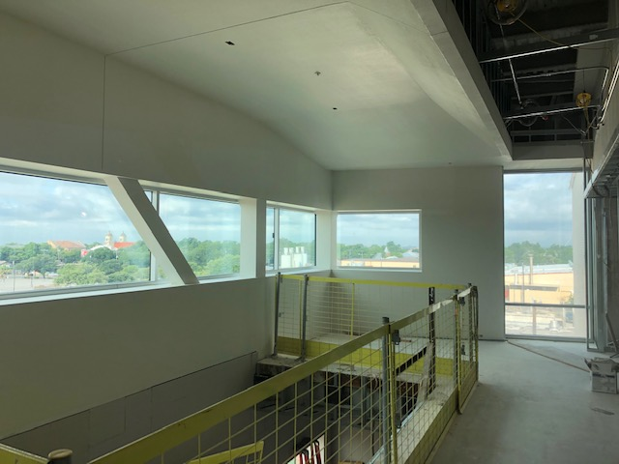
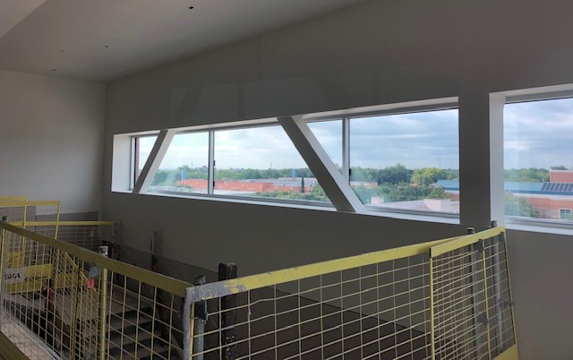
SPC – Norris Tech. Bldg. Renov.
IN CONSTRUCTION

Slide 24
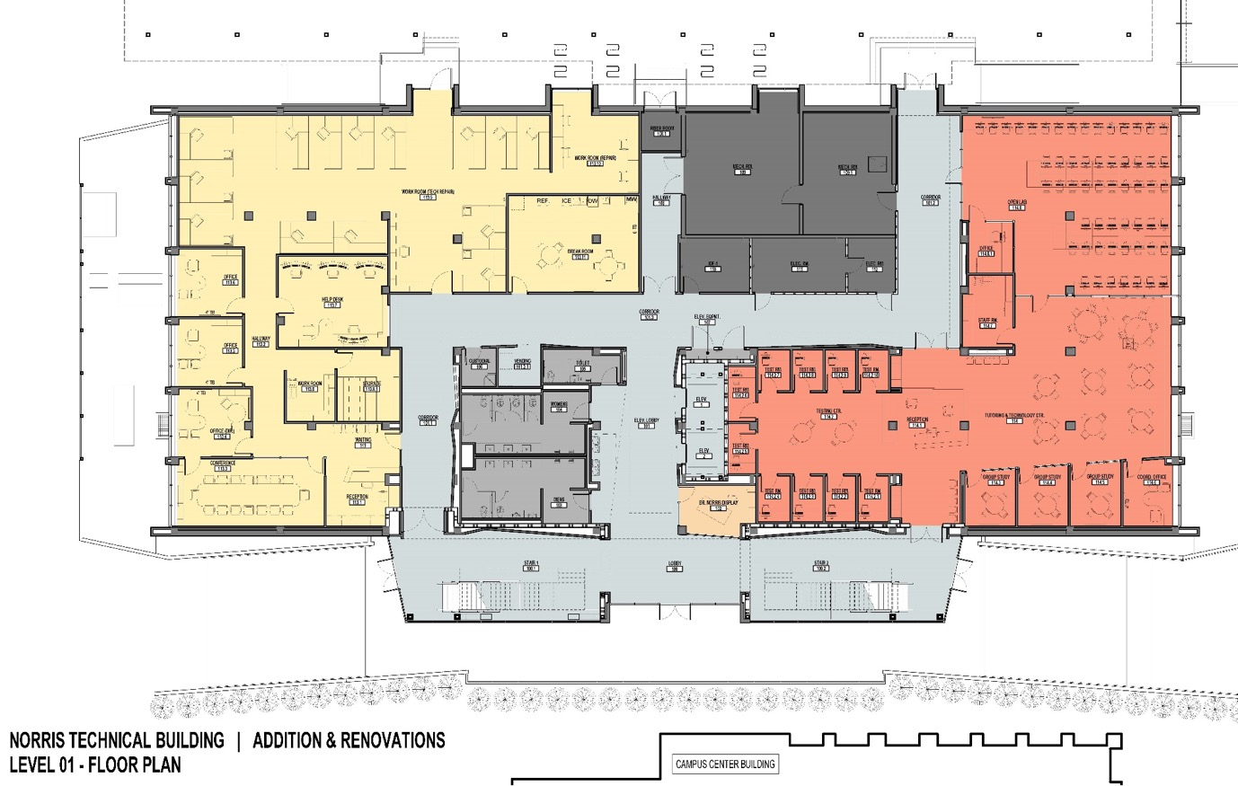
SPC – Norris Tech. Bldg. Renov.

Slide 25
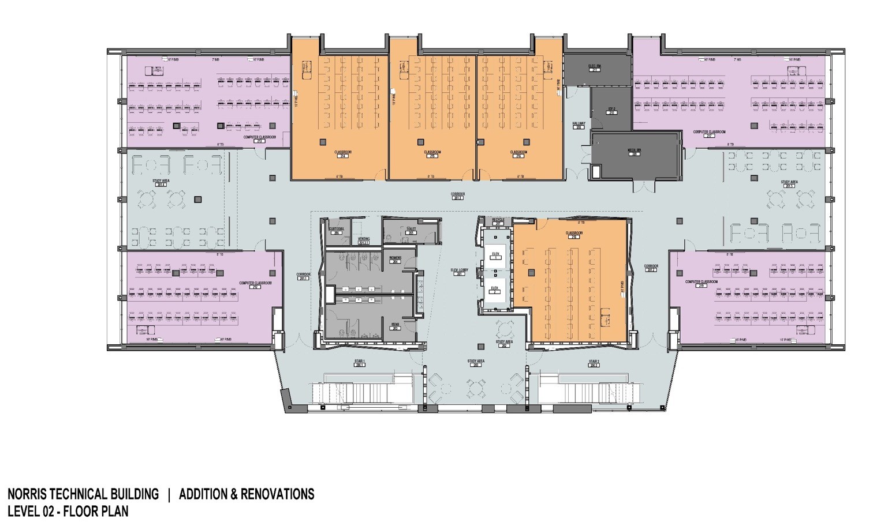
SPC – Norris Tech. Bldg. Renov.

Slide 26
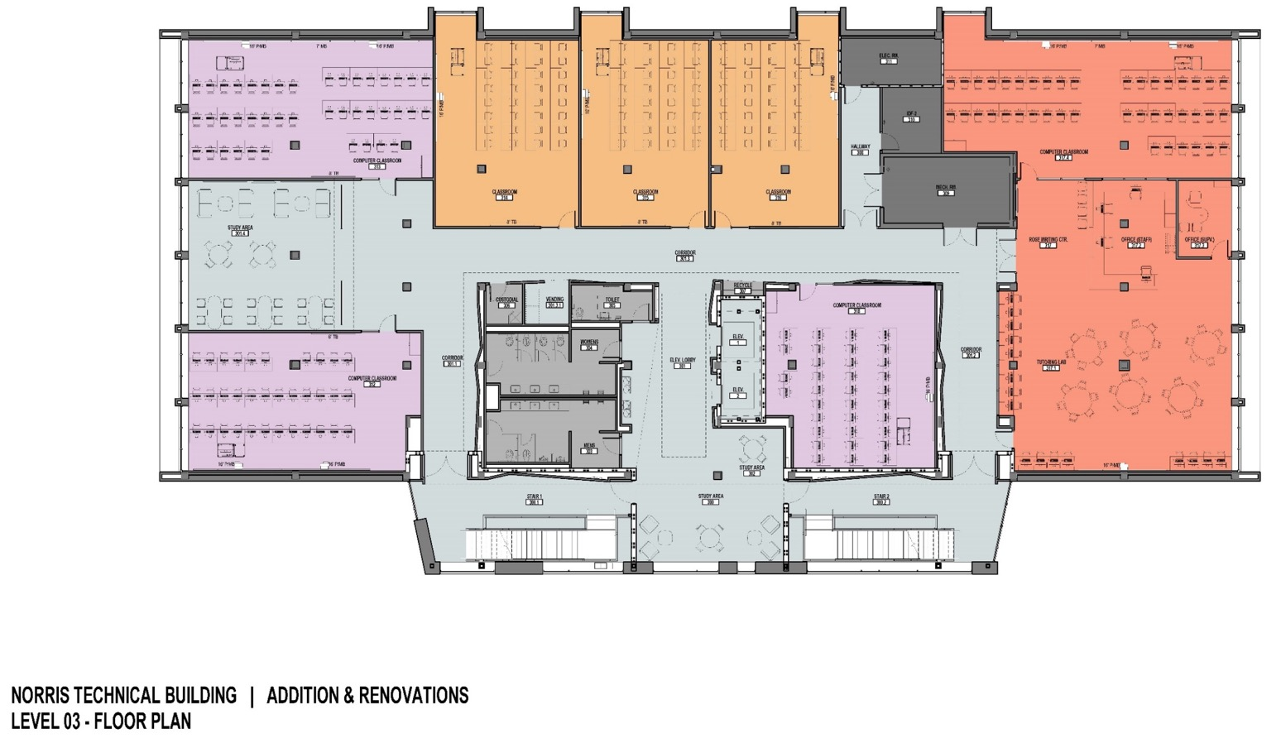
SPC – Norris Tech. Bldg. Renov.

Slide 27
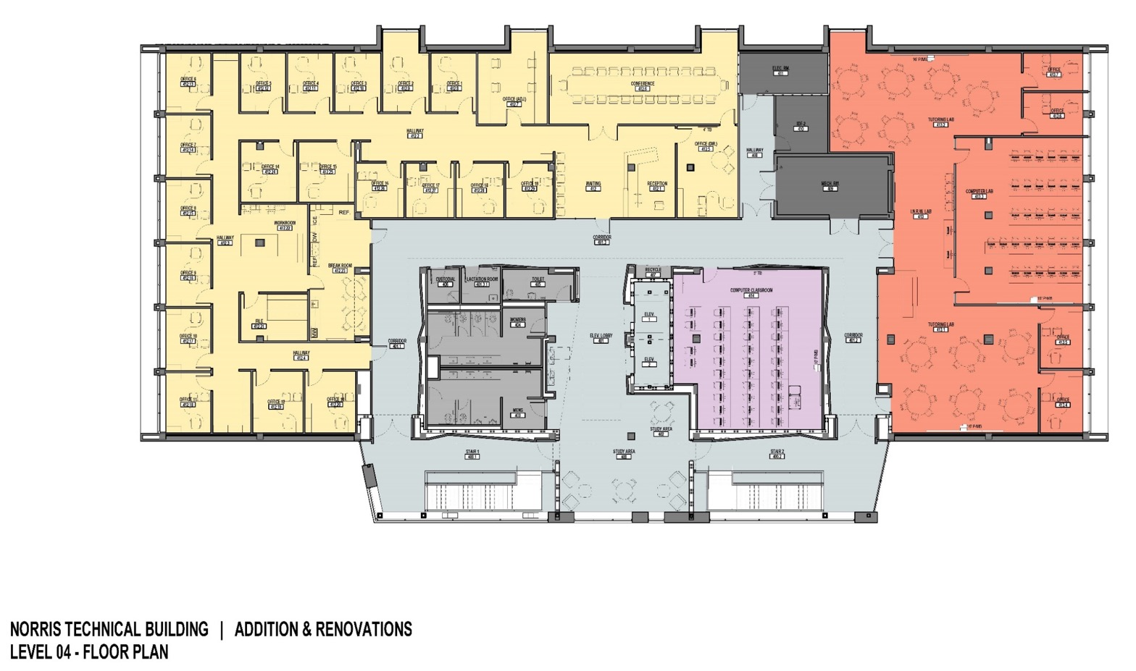
SPC – Norris Tech. Bldg. Renov.

Slide 28


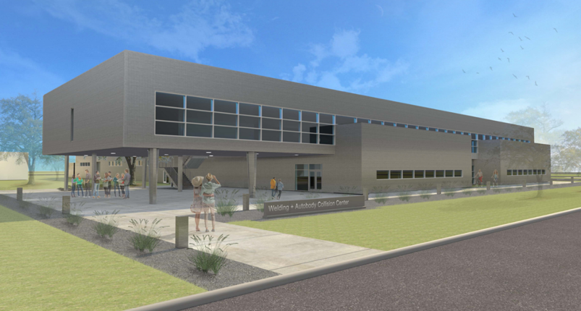
SPC SWC - Welding and Auto Body Facility
GMP Approved
Project Statistics:
Architect: WestEast Design Group
CMAR: Guido Construction Company, Inc.
GMP: $19,861,680
GMP Approved: 03.17.2020
Building Square Footage: 62,093 sf (1.5 stories)
Classrooms and Labs: 1 Large Multipurpose 3 Computer; 6 General; Labs: 2 Large Instructional Labs (Welding & Auto Body); 120 Welding Stations; 32 Auto Body Welding Stations; 2 Paint Booths; 1 Double Bay Prep
Est. Construction Start: July 2020
Est. Target Completion: March 2022
Est. Academic Term Opening: Spring 2022
CMAR SMWVBE % Committed: 25%
Construction % Complete: GMP Approved
G.O. BONDS | OTHER FUNDS | MAINTENANCE TAX NOTES | TOTAL FUNDING | EXPENSES THROUGH 6/18/20 | ESTIMATE TO COMPLETE
$23.12M | $1.96M (Inst. Budget) | $- | $25.07M | $1.2 | $23.87M
Notes:
ICON THEME: Advanced Manufacturing; Growth
Original $20M
Rebalance $22.4
Other funding $1.4M
MTN $
SMWVBE: 15%

Slide 29
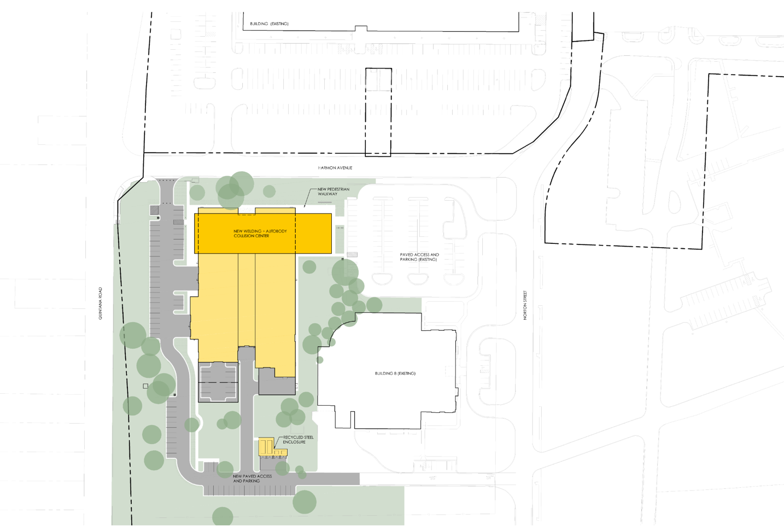
SPC SWC - Welding and Auto Body Facility
GMP Approved
Located at Quintana Road and Harmon Ave next to existing Building 8.
The new building will replace the existing older facility on the campus increasing square footage from 33,254sf to 62,093sf
siteplan

Slide 30
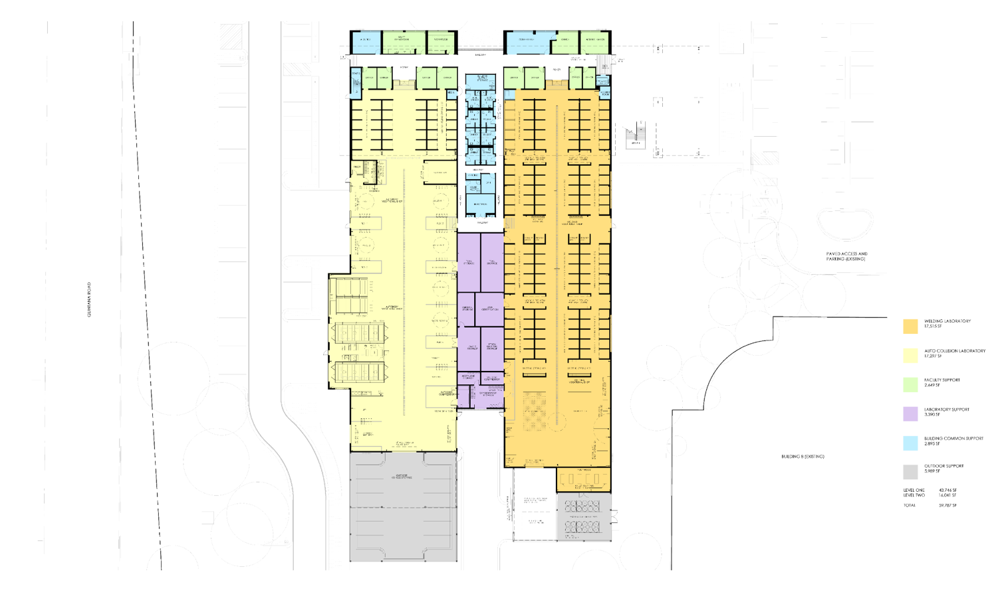
SPC SWC - Welding and Auto Body Facility
GMP Approved
Level 1
2 Large Instructional Laboratories
Welding Lab features
  120 Welding stations
Autobody Collision features
  32 Welding stations
  2 paint Booths
  1 Double Bay Prep Booth
Remaining Floor Area
Administrative spaces
Faculty Offices
Support Spaces

Slide 31
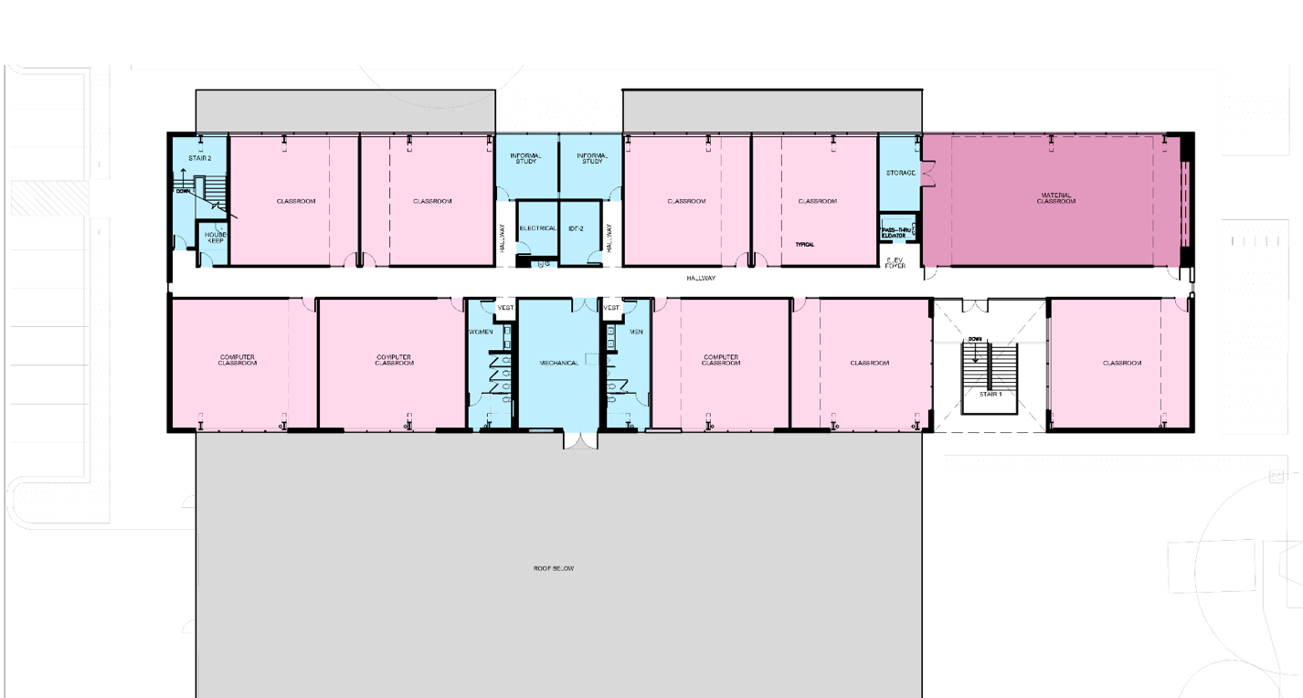
SPC SWC - Welding and Auto Body Facility
GMP Approved
Level 2
3 Computer Classrooms (seating 32)
6 General Classrooms
(seating 32)
Large Multipurpose Room (seating up to 100)
2 Informal Study Areas

Slide 32



SPC - Bowden Building
Project Statistics:
Architect: Page
CMAR: Skanska USA Building, Inc.
GMP: $10,806,501
GMP Approved: 05.19.2020
Building Square Footage: 24,870 sf (2 stories)
Classrooms and Labs: General and Computer
Labs: 3 Tradition 2 Collaborative Networking Labs;
Accounting and Technology Labs
Special Purpose Areas: Artemisia Bowden Bust
And Portrait, VITA (Volunteer Income Tax
Assistance) Center
Est. Construction Start: June 2020
Est. Target Completion: August 2021
Est. Academic Term Opening: Fall 2021
CMAR SMWVBE % Committed: 25%
Construction % Complete: NTP Proceed
GMP Approved/NTP
G.O. BONDS | OTHER FUNDS | MAINTENANCE TAX NOTES | TOTAL FUNDING | EXPENSES THROUGH 6/18/20 | ESTIMATE TO COMPLETE
$14M | $0.68M (Inst. Budget) | $- | $14.68M | $0.50M | $14.18M
Notes:
ICON THEME: Finance; Information Technology, and Growth
Original $10M
Rebalance $14M
Other funding $.7M
MTN $-
SMWVBE: %

Slide 33
SPC - Bowden Building
GMP Approved/NTP
Campus Site Plan
The replacement Bowden Building will be located at what will become the new main entry to the campus off of MLK Drive.
Building Site Plan

Slide 34
SPC - Bowden Building
GMP Approved/NTP

Slide 35
SPC - Bowden Building
GMP Approved/NTP
Main Lobby:
Bright / Open Space
Open Stair to Second Floor
Open Glazing to VITA and Dean Reception Areas
Museum-like Clean / Modern Aesthetic
Artemisia Bowden Bust and Portrait / Heritage Tree
High Tech Video Display Wall

Slide 36
SPC - Bowden Building
GMP Approved/NTP
First Floor
Main Reception Lobby
VITA Tax Assistance Center
General Classroom
Computer Classroom
Faculty Office Suite

Slide 37
SPC - Bowden Building
GMP Approved/NTP
Second Floor
3 Networking Computer Labs (Traditional Layout)
2 Networking Computer Labs (Collaborative Layout)
Dedicated Server Rooms
Accounting Lab
Technology Integration Lab
Informal Student Study Area

Slide 38

San Antonio College
Dr. Robert Vela, President

Slide 39
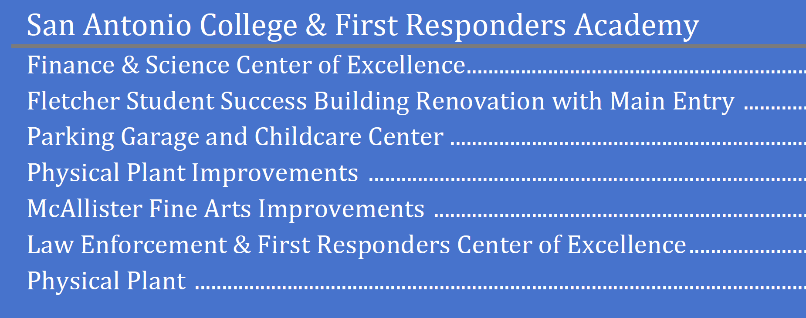
Chance Renov.: Fin.
NEW Science Bldg.
Garage/Street Work
Childcare Center
Deferred $4.5M
G.O. Bonds (per Election Flyer): $83 Million
Maintenance Tax Notes (approved 5/2019) $11.10 Million (Fletcher Renovation)

Slide 40
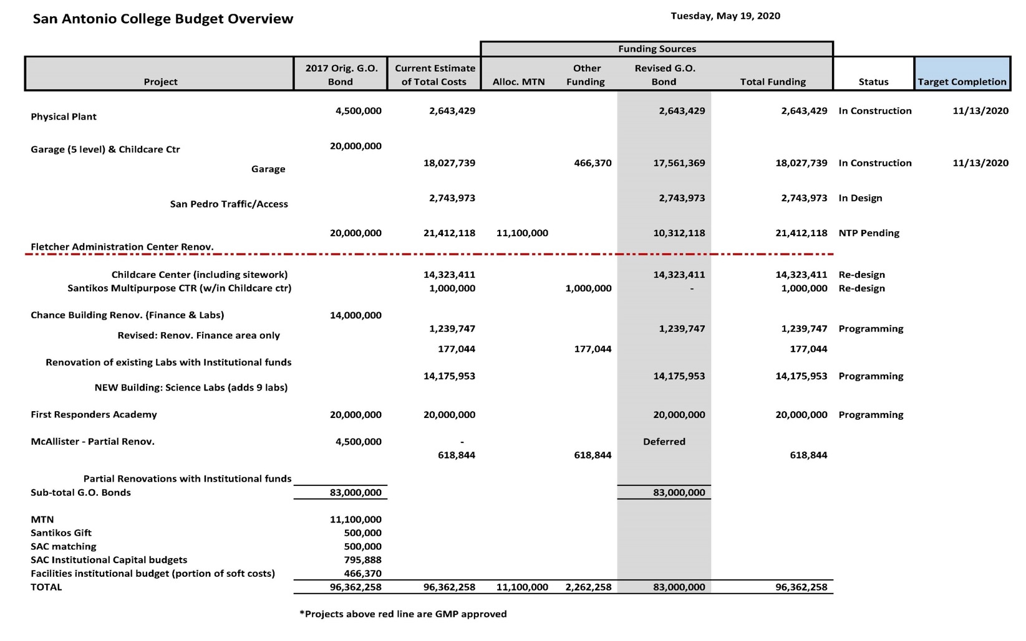
SAC Updated Budget Targets With MTN Impact
NTP Issued
10/2021

Slide 41
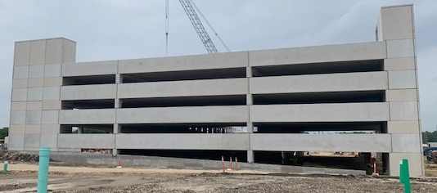
List of Projects
In Construction (3)
Physical Plant
Parking Garage/San Pedro Scope
Fletcher Administration Center Renov.
Future (4)
Childcare/Santikos Multipurpose Center
Chance Renov.
New Science Building (9 additional labs)
First Responders Academy
McAllister Renov. - Deferred
San Antonio College – Parking Garage / San Pedro Scope Improvements
College Campus | Orig. GO Bond | Allocation Of MTN | Other Funding | Revised GO Bond Plan | Total
SAC | $83M | $11.10M | $2.26M | $83M | $96.36M

Slide 42


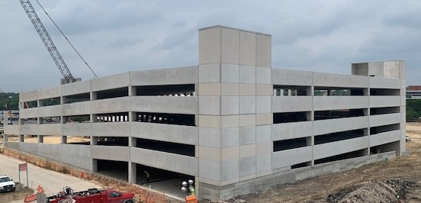
SAC – Parking Garage/Added Scope San Pedro Improvements
IN CONSTRUCTION
Project Statistics:
Architect: O’Connell Robertson
CMAR: J.T. Vaughn Construction, LLC
GMP, as Amended: $20,771,712
GMP Approved: 12.11.18, Amended on 05.19.2020
Parking Spaces: 732 (5 levels)*
Net Add of Parking Spaces: 355*
Added Scope: San Pedro Street Improvements
Construction Start: July 2019
Target Completion: September 2020
Academic Term Opening: Spring 2021
CMAR SMWVBE % Committed: 24%
Construction Complete: 60%
G.O. BONDS | OTHER FUNDS | MAINTENANCE TAX NOTES | TOTAL FUNDING | EXPENSES THROUGH 6/18/2020 | ESTIMATE TO COMPLETE
$20.31M | $0.47 | - | $20.77M | $10.70M | $10.07M
* Removed 1 level, due to re-evaluation of campus parking requirements
Notes:
ICON THEME: Growth and Student Support
Original $16M
Rebalance $19M
40% materials are already purchased
SMWVBE: 39.56%

Slide 43
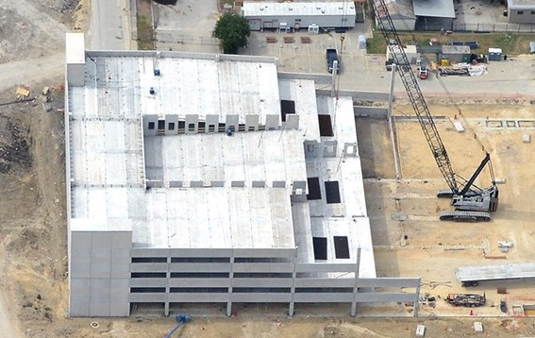
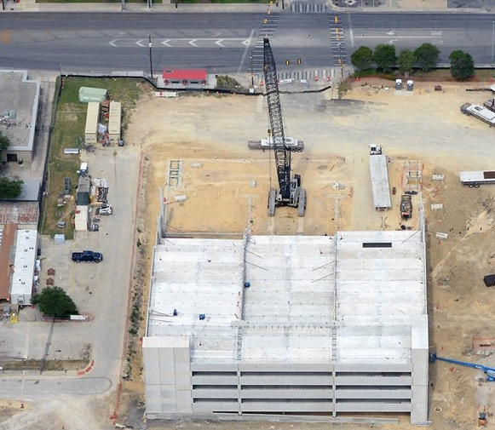
SAC – Parking Garage/Added Scope San Pedro Improvements
IN CONSTRUCTION

Slide 44
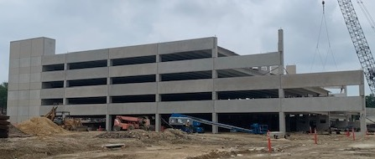
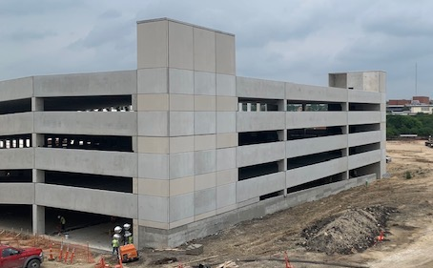
SAC – Parking Garage/Added Scope San Pedro Improvements
IN CONSTRUCTION

Slide 45

SAC – Parking Garage Added Scope San Pedro Improvements
Why San Pedro Street Improvements?
Required added scope by City Of San Antonio.
Determined by Traffic Impact Analysis.
Required to obtain Certificate of Completion

Slide 46
SAC – Parking Garage/Added Scope San Pedro Improvements
IN CONSTRUCTION
W. PARK
W. MYRTLE
W. EVERGREEN ST.
MAVERICK

Slide 47
SAC – Parking Garage Added Scope San Pedro Improvements
Improvements from W Evergreen St. to 400ft past W Myrtle St.
Removal and re-installation of concrete sidewalks
Addition of concrete medians for traffic turn lanes at W Park and Scobee Loop Exit onto San Pedro
Traffic signal revisions
  underground electrical at West Park due to deletion of W Park Street into campus.
  Includes underground electrical at W Myrtle due to the addition of Scobee Loop exiting onto San Pedro Ave
Coordination with CPS for Power requirements
Storm drain utilities at exit from Scobee Loop onto San Pedro Ave
Temporary traffic lane closures and re-routing to accommodate construction
Pavement markings, signage, and ADA crossings

Slide 48
SAC – Physical Plant
IN CONSTRUCTION
Project Statistics:
Architect: O’Connell Robertson
CMAR: J.T. Vaughn Construction, LLC
GMP: $2,820,596
GMP Approved: 12.11.18
Academic Term Opening: Spring 2021
Target Construction Start: July 2019
Target Completion: September 2020
Construction % Complete: 85%
Current scope covers no expansion to building/equipment, only utility connections from plant to new buildings.
Estimated savings to occur on project reducing the GMP
G.O. BONDS | OTHER FUNDS | MAINTENANCE TAX NOTES | TOTAL FUNDING | EXPENSES THROUGH 6/18/2020 | ESTIMATE TO COMPLETE
$2.64M | - | - | $2.64M | $1.7M | $0.94M
Notes:
ICON THEME: Growth
Original $4.5
Rebalance $2.6M

Slide 49




SAC – Fletcher Admin. Center Renov.
Project Statistics:
Architect: O’Connell Robertson
CMAR: J.T. Vaughn Construction, LLC
GMP: $18,552,118
GMP Approved: 1.21.20
Building Square Footage: 60,039 sf
Classrooms and Labs: Tino & Millie Duran Welcome Center; Multipurpose Room; Outreach Recruitment; Testing & Advising; Admissions & Records; Technology Center; Student Lounge, Technology Center & Café; Business Office & Financial Aid. Labs: Testing Labs
Est. Target Construction Start: June 2020
Est. Target Completion: October 2021
Est. Academic Term Opening: Spring 2022
CMAR SMWVBE % Committed: 24%
Construction % Complete: 2%
In Construction
G.O. BONDS | OTHER FUNDS | MAINTENANCE TAX NOTES | TOTAL FUNDING | EXPENSES THROUGH 6/18/20 | ESTIMATE TO COMPLETE
$10.31M | $- | $11.10M | $21.41M | $1.28M | $20.13
Notes:
ICON THEME: Student Support, Finance; and Growth
Original $20M
Rebalance $10.3M
SMWVBE: %

Slide 50


SAC – Fletcher Admin. Center Renov.
In Construction
N. MAIN AVENUE
W. EVERGREEN
Building Site Plan

Slide 51


New Main Entry
SAC – Fletcher Admin. Center Renov.
In Construction
Ramp Accessibility
Outdoor Learning Area
Patio Seating
Fletcher Student Success Administration Building – New Main Entry
Fletcher – Current

Slide 52


SAC – Fletcher Admin. Center Renov.
In Construction
East Aerial View
Southeast Aerial View

Slide 53


SAC – Fletcher Admin. Center Renov.
In Construction
Admissions & Records
Assessment & Advising Center
Testing Center
Outreach Recruitment
Multipurpose Event Room
1st Floor/Basement

Slide 54


Student Technology Center
Student Orientation Center
Business Office
Financial Aid
2nd Floor
Tino & Millie Duran Welcome Center
Student Lounge
Student Café

Slide 55

In Construction
Offices
Multipurpose Conference Rooms
3rd Floor

Slide 56

Northwest Vista College
Dr. Ric Baser, President

Slide 57


Garage
Welcome Center
Cypress Renovation
Utilities Connections Only
G.O. Bonds (per Election Flyer): $69 Million
Maintenance Tax Notes (approved 5/2019) $10 Million (Cypress Renovation)

Slide 58

NVC Updated Budget Targets With MTN Impact
NTP Issued
Parking Garage and Welcome Center $26M project was split into two structures next to each other
Notes:
Red dot visually of the construction and those to come in future.
Target Completion dates are past (Feb and March – shouldn’t that be future?)

Slide 59

List of Projects
In Construction (3)
Physical Plant
Texas Ash Parking Garage
Desert Willow Welcome Center
GMP Approved (1)
Northwest Vista College – STEM Center of Excellence
STEM Center of Excellence (NTP Issued) April 2020
Future (1)
Cypress Cultural Center of Excellence Renov.
College Campus | Orig. GO Bond | Allocation Of MTN | Other Funding | Revised GO Bond Plan | Total
NVC | $69.0M | $10.0M | $ | $69.0M | $79.0M

Slide 60





NVC – Desert Willow Welcome Center
SUBSTANTIAL COMPLETION
Project Statistics:
Architect: Alamo Architects
CMAR: SpawGlass Contractors, Inc.
GMP, as Amended: $13,855,466
GMP Approved: 12.11.18, Amended on 10.22.19
Building Square Footage: 53,157 sf
Student Resources: Vista Central Admissions & Records, Business Services, Financial Aid, Wellness, Advising & Testing
Construction Start: October 2019
Target Completion: July 2020
Academic Term Opening: Summer 2020
CMAR SMWVBE % Committed: 25%
Construction Complete: 90%
G.O. BONDS | OTHER FUNDS | MAINTENANCE TAX NOTES | TOTAL FUNDING | EXPENSES THROUGH 6/18/20 | ESTIMATE TO COMPLETE
$17.87M | $- | $1.82M | $19.69M | $14.9M | $4.7M
Notes:
ICON THEME: Student Support, Information Technology, Growths
Original $17 M
Rebalance $19M
Estimate to complete is the difference between total GO Bond less expenses.
Original GMP amount $14,045,605 deducted ($190,139.00)
Original GMP approve date 12.11.18
SMWVBE: 17%
If there is amendment, make to sure to include in the Stats
Also include amend date
If Academic its about the students
If its welcome center –
Place the Icons near the name.
Remove special purposes
Expenses are showing the first buckets actuals.

Slide 61


NVC – Desert Willow Welcome Center

Slide 62


NVC – Desert Willow Welcome Center
1st Floor Lobby Atrium

Slide 63



NVC – Desert Willow Welcome Center
Wellness
Vista Central Admissions and Records

Slide 64


NVC – Texas Ash Parking Garage
IN CONSTRUCTION
Project Statistics:
Architect: Alamo Architects
CMAR: SpawGlass Contractors, Inc.
GMP, as Amended: $8,360,243
GMP Approved: 12.11.18, Amended on 10.22.19
Parking Spaces: 451 (4 Levels)
Net Add of Parking Spaces: 451
Construction Start: October 2019
Target Completion: July 2020
Academic Term Opening: Summer 2020
CMAR SMWVBE % Committed: 25%
Construction % Complete: 65%
G.O. BONDS | OTHER FUNDS | MAINTENANCE TAX NOTES | TOTAL FUNDING | EXPENSES THROUGH 2/20/20 | ESTIMATE TO COMPLETE
$9.76M | - | - | $9.76M | $8.28M | $1.48M
Notes:
ICON THEME: Growth
Original $9 M
Rebalance $9.8M
Estimate to complete is the difference between total GO Bond less expenses
Original GMP amount $7,968,892 added $391,351.00
Original GMP approved 12.11.18
SMWVBE: 22%

Slide 65


NVC – Texas Ash Parking Garage
IN CONSTRUCTION
Notes:
ICON THEME: Growth
Original $9 M
Rebalance $9.8M
Estimate to complete is the difference between total GO Bond less expenses
Original GMP amount $7,968,892 added $391,351.00
Original GMP approved 12.11.18
SMWVBE: 22%

Slide 66


NVC – Texas Ash Parking Garage
IN CONSTRUCTION
Notes:
ICON THEME: Growth
Original $9 M
Rebalance $9.8M
Estimate to complete is the difference between total GO Bond less expenses
Original GMP amount $7,968,892 added $391,351.00
Original GMP approved 12.11.18
SMWVBE: 22%

Slide 67
NVC – Physical Plant
IN CONSTRUCTION
Project Statistics:
Architect: Alamo Architects
CMAR: SpawGlass Contractors, Inc.
GMP, as amended: $2,798,788
GMP Approved: 12.11.18, Amended on 10.22.19
Building Square Footage: N/A
Construction Start: October 2019
Target Completion: July 2020
Construction % Complete: 70%
Current scope covers no expansion to building/equipment, only utility connections from plant to new buildings.
G.O. BONDS | OTHER FUNDS | MAINTENANCE TAX NOTES | TOTAL FUNDING | EXPENSES THROUGH 6/18/20 | ESTIMATE TO COMPLETE
$2.80M | $- | $- | $2.80M | $1.69M | $1.11M
Notes:
ICON THEME: Growth
Original $3 M
Rebalance $2.8M
Estimate to complete is the difference between total GO Bond less expenses.
Original GMP amount $2,700,000 deducting $(322,832.00)
Original GMP approve date 12.11.18
CMAR SMWVBE % Committed: 25%
SMWVBE: 19%

Slide 68


NVC – STEM Center of Excellence
Project Statistics:
Architect: Overland Partners
CMAR: SpawGlass Contractors, Inc.
GMP: $24,519,433
GMP Approved: 03.17.2020
Building Square Footage: 53,044 sf (3 Stories)
Classrooms: 17 Classrooms
Labs: 7 Labs -Physics, Genetics, Chemistry;
Tutoring – 1 Room
Est. Construction Start: June 2020
Est. Target Completion: September 2021
Est. Academic Term Opening: Fall 2021
CMAR SMWVBE % Committed: 25%
Construction % Complete: GMP Approved
GMP Approved
G.O. BONDS | OTHER FUNDS | MAINTENANCE TAX NOTES | TOTAL FUNDING | EXPENSES THROUGH 6/18/20 | ESTIMATE TO COMPLETE
$33.90M | $- | $- | $33.90M | $1.48M | $32.42M
Notes:
ICON THEME: STEM LABS; Growth
Original $30M
Rebalance $33.9
SMWVBE: %

Slide 69
NVC – STEM Center of Excellence
STEM Site Plan
NVC Campus

Slide 70


NVC – STEM Center of Excellence
GMP Approved
East Aerial View
North Aerial View

Slide 71


NVC – STEM Center of Excellence
GMP Approved
1st Floor Lobby Rendering
2nd Floor Atrium Rendering

Slide 72

NVC – STEM Center of Excellence
GMP Approved
Student Lounge
Tutoring Center
Dean’s Suite
2nd Level Student Lounge

Slide 73

NVC – STEM Center of Excellence
GMP Approved
Study Spaces
Faculty Suite
3rd Level Collaborative Space

Slide 74


NVC – Cypress Cultural Center of Excellence Renov.
Future
Project Statistics:
Architect: Overland Partners
CMAR: SpawGlass Contractors, Inc.
GMP:
GMP Approved:
Building Square Footage:
Est. Target Completion: Pending GMP
Classrooms and Labs: Classrooms,
Cultural Center. Labs: Archeology and Geography
Est. Target Construction Start: Pending GMP
Est. Target Completion: Pending GMP
Est. Academic Term Opening: Pending GMP
CMAR WMBVBE % Committed: 25%
Construction Complete: Pending GMP
G.O. BONDS | OTHER FUNDS | MAINTENANCE TAX NOTES | TOTAL FUNDING | EXPENSES THROUGH 6/18/20 | ESTIMATE TO COMPLETE
$4.67M | $- | $8.18M | $12.85M | $0.29M | $12.56M
Notes:
ICON THEME: Student Support; Growth
Original $30M
Rebalance $33.9
SMWVBE: %

Slide 75

Palo Alto College
Dr. Robert Garza, President

Slide 76

New Multi-purpose Bldg:
Adv. Manuf./Public Service
Welcome Ctr
Defer Palomino Renov./ Healthcare in Multi-purpose Bldg.
Joint w/ COSA
Defer lab renov./ Added Labs in Multi-Purpose Bldg.
G.O. Bonds (per Election Flyer): $66 Million
COSA Bonds –approx. 49% Natatorium $ 5.3 Million
Maintenance Tax Notes (approved 5/2019) $ 9.8 Million (Gym/Nat. Renovation)

Slide 77

PAC Updated Budget Targets With MTN Impact
Currently Value Engineering to be within budget
Currently out for bid
Currently Value Engineering to be within budget
** The four separate projects are proposed to be combined into one new Multi-Purpose Building to allow for great efficiencies including new science labs (rather than renovating the existing Science building) and new dental program (rather than renovating Palomino for healthcare programs).

Slide 78

List of Projects
GMP Within Three Months (3)
Natatorium & Gym Renov. *July 2020
Multipurpose Building (Est. Aug.)
Physical Plant Improvements Renov. (Est. Sept.)
Palo Alto College – Multipurpose Building
College Campus | Orig. GO Bond | Allocation Of MTN | Other Funding | Revised GO Bond Plan | Total
PAC | $71.30M | $9.80M | $1.97M | $71.30M | $83.07M

Slide 79
Site Map
PAC – Master Site Plan

Slide 80


PAC – Natatorium & Gym Renov.
GMP within 3 Months
Project Statistics:
Architect: RVK Architects/Lopez Salas Architects
CMAR: Bartlett Cocke General Contractors
GMP: $
GMP Approved:
Building Square Footage: 90,334 sf (approx.)
Building Upgrades: New Exterior Finishes; Roof Profile and Panels; LED Lighting; Fire Sprinkler System; Interior Finishes; Tile Pool Surface Area. Upgrade Dressing Rooms, Showers and Restrooms Refurbish Diving Platforms
Est. Target Construction Start: *July 2020
Est. Target Completion:
Est. Academic Term Opening: Spring 2022
CMAR SMWVBE % Committed: 40%
Construction % Complete: Pending GMP
G.O. BONDS | OTHER FUNDS | MAINTENANCE TAX NOTES | TOTAL FUNDING | EXPENSES THROUGH 6/18/20 | ESTIMATE TO COMPLETE
$4.7M | $5.3M CoSA | $9.80M | $19.82M | $1.15M | $18.67M
Notes:
ICON THEME: Growth
Original $8.3 +5.7 =$14M
Rebalance $4.7M
SMWVBE: %

Slide 81

PAC – Natatorium Renovation
CoSA Interlocal Funding Agreement
GMP within 3 Months
Interlocal Funding Agreement:
Details CoSA Financial contribution and Outlines Proportionate expenditures for Maintenance & Capital Improvements
  Total Natatorium Funding: $11M
  CoSA Committed Funding $5,194,000
    $106,000 Admin Cost (kept by CoSA)
  ACD Committed Funding $5.7 M
Percentage Ownership: 49% CoSA / 51% ACD
  Pursuant to a Financing and Joint Use Agreement dated May 17, 1989
May 6, 2017 Election Bonds: Included funds for renovation of the Natatorium in their respective Districts.
Notes:
Add a minute order slide about the PAC CoSA funding agreement within the presentation
CoSA did bond same time as we did
59/41 % ownership
Funding agreement is the joint funding for construction
When was nata built? 1988 --------Mid 90’s had Olympic and used the Nat.
Need ACD board approval prior to CoSA Council Meeting
Add add’l MO for COSA funding agreement for Natatorium

Slide 82

PAC – Natatorium & Gym Renov.
GMP within 3 Months
Southwest Elevation
New Exterior finishes * New roof profile * New Roof Panels * Upgrade dressing rooms, showers & restrooms * New tile at pool surface area * Refurbish diving platforms * New LED lighting * New Fire Sprinkler System * New interior finishes

Slide 83

PAC – Natatorium & Gym Renov.
Renovation Improvement Upgrades
Installation of a new fire sprinkler system.
Installation of a new air and ventilation materials and equipment.
Upgrade I.T. cabling and equipment.
Upgrade automation controls.
New LED Lighting and related electrical upgrades
Window repair or replacement as required to make the building more energy efficient.
New metal roof, skylights and new fall protection system.
GMP within 3 Months
Natatorium/Gym - Lobby

Slide 84




PAC – Multipurpose Building
Project Statistics:
Architect: RVK Architects/Lopez Salas Architects
CMAR: Bartlett Cocke General Contractors
GMP: $
GMP Approved:
Building Square Footage: 128,000 sf (approx.)
Classrooms and Labs: Advance Manufacturing Center, Labs; Public Service Center; Student Engagement & Welcome Center; Healthcare Technology Center of Excellence; Dental Clinic for Community Use; Cyber Security Lab; Science Labs; Simulated Courtroom. Labs: Geology, Physics Biochemistry, Chemistry
Est. Target Construction Start: August 2020
Est. Target Completion: July 2022
Est. Academic Term Opening: Fall 2022
CMAR SMWVBE % Committed: 40%
Construction % Complete: Pending GMP
GMP within 3 Months
G.O. BONDS | OTHER FUNDS | MAINTENANCE TAX NOTES | TOTAL FUNDING | EXPENSES THROUGH 6/18/20 | ESTIMATE TO COMPLETE
$57.78M | $1.97M | $- | $59.75M | $1.55M | $58.19M
Notes:
ICON THEME: Health /Bioscience; Student Support; Information Technology; and Growth
Original $49M
Rebalance $57.7
SMWVBE: %

Slide 85


PAC – Multipurpose Building
GMP within 3 Months
West Elevation - Entry
South Elevation

Slide 86
PAC – Multipurpose Building
GMP within 3 Months
Corridor West Entry
Lobby Area
West Elevation - Entry

Slide 87

PAC – Physical Plant Renov.
GMP within 3 Months
Project Statistics:
Architect: RVK Architects/Lopez Salas Architects
CMAR: Bartlett Cocke General Contractors
GMP: $
GMP Approved:
Building Square Footage: 2,800 sf (approx.)
Building Components: Support Mechanical Campus Requirements; 1 New Chiller with Room for Future Additions
Est. Target Construction Start: September 2020
Est. Target Completion: November 2021
CMAR SMWVBE % Committed: 40%
Construction % Complete: Pending GMP
G.O. BONDS | OTHER FUNDS | MAINTENANCE TAX NOTES | TOTAL FUNDING | EXPENSES THROUGH 6/18/20 | ESTIMATE TO COMPLETE
$3.50M | $- | $- | $3.50M | $3.07M | $3.43M
Notes:
ICON THEME: Growth
Original $3M
Rebalance $3.5M
$11K
SMWVBE: %

Slide 88

Northeast Lakeview College
Dr. Veronica Garcia, President

Slide 89

Combined
PPI not required
G.O. Bonds (per Election Flyer): $42 Million
Maintenance Tax Notes (approved 5/2019) $8.1 Million (FF&E; add’l NLC Renov.)

Slide 90

NLC Updated Budget Targets With MTN Impact

Slide 91

List of Projects
Future (1)
STEM Science and Technology Building Center of Excellence (Est. Sept.)
  Physical Plant (combined/not required)
Northeast Lakeview College – STEM Building
College Campus | Orig. GO Bond | Allocation Of MTN | Other Funding | Revised GO Bond Plan | Total
NLC | $42.0M | $8.10M* | $- | $42.0M | $50.10M
*This is the maximum MTN available. MTN use on new buildings is restricted to furniture, fixture and equipment.

Slide 92





NLC – STEM Science and Technology
Center of Excellence
Future
Project Statistics:
Architect: Ford Powell Carson
CMAR: Turner Construction Co.
GMP: $
GMP Approved:
Building Square Footage: 89,052 sf
Classrooms and Labs: 10 General, 4 Computer, Engineering, 1 Multifunction Room. Labs: Geology, Physics, Biochemistry, Chemistry, Technical
Est. Target Construction Start: September 2020
Est. Target Completion: June 2022
Est. Academic Term Opening: Fall 2022
CMAR SMWVBE % Committed: 30%
Construction % Complete: Pending GMP
G.O. BONDS | OTHER FUNDS | MAINTENANCE TAX NOTES | TOTAL FUNDING | EXPENSES THROUGH 6/18/20 | ESTIMATE TO COMPLETE
$42.0M | $ | $8.10M* | $50.10M | $1.69M | $48.41M
*This is the maximum MTN available. MTN use on new buildings is restricted to furniture, fixture and equipment.
Notes:
ICON THEME: Health/Bioscience; STEM Lab; Student Support; Information Technology; and Growth
Original $40M
Rebalance$42M
SMWVBE: %

Slide 93


NLC – STEM Science and Technology
Center of Excellence
Future
South Courtyard View
East Aerial View

Slide 94

Education and Training Center
Xavier Urrutia, Interim VCEWD

Slide 95

List of Projects
GMP Approved (1)
Westside Education and Training Center February 2020
Future (2)
I-10 Northwest Education and Training Center (Est. Sept.)
Southside Education and Training Center (Est. Jan 2021.)
Westside Education and Training Center
College Campus | Orig. GO Bond | Allocation Of MTN | Other Funding | Revised GO Bond Plan | Total
Education Training Centers | $69.0M | $- | $0.80M | $- | $69.80M

Slide 96


Westside Education and Training Center (WETC)
GMP Approved
Project Statistics:
Architect: HKS
CMAR: Joeris General Contractors
GMP: $18,500,000
GMP Approved: Feb 18, 2020
Building Square Footage: 46,907 sf
Classrooms and Labs: Veterans Outreach, Student Collaboration Areas, Digital Library, Testing Center. Labs: Nanotech Lab, Water Resource Lab, Chemistry Lab Biology Lab (Shell)
Est. Target Construction Start: *Pending Land Purchase (LP)
Est. Target Completion:
Est. Academic Term Opening:
CMAR SMWVBE % Committed: 35%
Construction % Complete: Pending LP
G.O. BONDS | OTHER FUNDS | MAINTENANCE TAX NOTES | TOTAL FUNDING | EXPENSES THROUGH 6/18/2020 | ESTIMATE TO COMPLETE
$23.0M | $0.80M | $- | $23.80M | $1.14 | $22.66M
Notes:
ICON THEME: Health/ Bioscience; Student Support; and Growth
Original $23M
Cosa $500K
Veterans $300K
Need from Jennifer..
$843K
SMWVBE: %

Slide 97


Westside Education & Training Center (WETC)
GMP Approved
South Aerial View
West Aerial View

Slide 98

Westside Education & Training Center (WETC)
GMP Approved
Main Entry

Slide 99


Westside Education & Training Center (WETC)
GMP Approved
Building “B” Learning Stair Level 2
Building “A” Lobby/Learning Stair

Slide 100


Westside Education & Training Center (WETC)
GMP Approved
Building “A” Digital Library

Slide 101




Northwest Education and Training Center (NWETC)
Future
Project Statistics:
Architect: Overland Partners
CMAR: Sundt Construction, Inc.
GMP: $
GMP Approved:
Building Square Footage: 42,000 sf
Classrooms and Labs: General Classrooms, Computer, Technical, Cyber-Tech, Tutorial. Labs: Biology and Chemistry
Est. Target Construction Start: Sept 2020
Est. Target Completion:
Est. Academic Term Opening: Spring 2022
CMAR SMWVBE % Committed: 22%
Construction % Complete: Pending GMP
G.O. BONDS | OTHER FUNDS | MAINTENANCE TAX NOTES | TOTAL FUNDING | EXPENSES THROUGH 6/18/20 | ESTIMATE TO COMPLETE
$23.0M | - | - | $23.0M | $1.18M | $21.82M
Notes:
ICON THEME: Health/Bioscience; Information Technology; and Growth
Original
$Get expenses from Jennifer/Carol
$463K
SMWVBE: %

Slide 102


Northwest Education & Training Center (NWETC)
Future
First Floor Plan
Second Floor Plan

Slide 103




Southside Education and Training Center (SETC)
Project Statistics:
Architect: Lake Flato
CMAR: Thomas S. Byrne dba Bryne Const. Serv.
GMP: $
GMP Approved:
Building Square Footage: 53,716 sf
Classrooms and Labs: Biblotech, Training Rooms, Robotics, Multipurpose Room, AMT, Allied Health, Nursing spaces, Faculty Office, Conference Room. Labs: Computer Labs, Classrooms, Skills/SIM Lab
Est. Target Construction Start: January 2021
Est. Target Completion:
Est. Academic Term Opening: Fall 2022
CMAR SMWVBE % Committed: 30%
Construction % Complete: Pending GMP
Future
G.O. BONDS | OTHER FUNDS | MAINTENANCE TAX NOTES | TOTAL FUNDING | EXPENSES THROUGH 6/18/20 | ESTIMATE TO COMPLETE
$23.0M | - | - | $23.0M | $0.61 | $22.39M
Notes:
ICON THEME: Health/Bioscience; Advanced Manufacturing; and Growth
Check with Jennifer and Carol
$50K
SMWVBE: %

Slide 104


SETC – Site Plan
Future

Slide 105

SETC – Schematic Floor Plan
Future

Slide 106

SETC – Schematic Exterior View
Future

Slide 107


SETC – Schematic Exterior Views
Future

Slide 108


SETC – Interior Schematics
Future

Slide 109



CIP Technology Investments

Slide 110
Technology Domains
Investment Area | Approved Budget
Infrastructure and ACOL | $11,600,000
Instructional Technology | $1,500,000
Communication/Collaboration Tools | $4,100,000
Reporting and Analytics | $1,700,000
Mobile Technology and Security | $6,100,000
 | $25,000,000

Slide 111
Infrastructure and ACOL
Project | Investment as of June 2020
Switch Refresh | $2,877,530
Storage Upgrade | $596,102
Wireless Refresh / Expansion | $322,373
UPS Refresh | $380,517
ERP Platform Upgrade | $285,041
 | $4,461,563

Slide 112
Instructional Technology
Project | Investment as of June 2020
iPad Mobile Labs | $142,755
Charging Stations | $248,682
VDI Refresh / Expansion | $398,719
 | $790,156

Slide 113
Communication / Collaboration Tools
Project | Investment as of June 2020
Alamo Cloud & Security Initiative | $2,503,157
Unified Communications: VOIP Refresh | $561,847
 | $3,065,004

Slide 114
Reporting and Analytics
Project | Investment as of June 2020
Data Warehouse | $0
Business Intelligence Tools | $0

Slide 115
Mobile Technology and Security
Project | Investment as of June 2020
Data Vault | $1,351,208
Laptops: Students | $1,217,700
Laptops: Employees | $1,115,542
 | $3,684,450

Slide 116
Investment Summary
Investment | Approved Budget | Investment as of June 2020
Infrastructure and ACOL | $11,600,000 | $4,461,563
Instructional Technology | $1,500,000 | $790,156
Communication/Collaboration Tools | $4,100,000 | $3,065,004
Reporting and Analytics | $1,700,000 | $0
Mobile Technology and Security | $6,100,000 | $3,684,450
 | $25,000,000 | $12,001,173

Slide 117
Projects Under Review / In Flight
Project | Potential Investment
Digital Signage | $1,200,000
VDI Refresh / Expansion | $1,500,000
Virtual Reality Classrooms/Labs | TBD
Fiber Linkages | TBD
Firewall Upgrade | TBD
Mobile Apps Strategy | TBD
E-Sports | TBD

Slide 118
Project Adds, Deletes, Modifications
Project | Potential Investment
Charging Stations & iPad Labs | Add
Student / Employee Laptops | Add
Data Vault | Add
Business Intelligence Tools | Delete
Geolocation Technology | Delete
Digital Signage | Modify

Slide 119




Slide 120
Construction Manager’s (CMAR) SMWVBE Subcontracting Plans

Slide 121

Bid/Vender/SMWVBE Management System
Improved Process - One Stop Portal:
Bid opportunities (including other agencies) Vendor Registration
SMWVBE training opportunities Subcontractor payment tracking

Slide 122


Slide 123


Slide 124


Slide 125


Slide 126
Schedule Next Meeting
Closing Comments

Slide 127

Thank you

Slide 128
Appendix

Slide 129
Citizens Bond Oversight Committee Charge
To accomplish its purpose, the CBOC will:
Determine Committee organizational structure and processes
Meet at least twice per fiscal year
Issue at least 2 written reports to the ACD Board
Monitor the timing and progress of voter approved projects
Review the budget and budget status of the overall bond program and individual projects
Ensure that general contractors seek Better/Builder/Workers Defense Program certification
Monitor diversity utilization including HUB and/or MWBE
Review scope changes in the bond program that may become necessary
Provide input from the community on issues related to the program

Slide 130
Citizens Bond Oversight Committee
Approved by the ACD Board of Trustees May 15, 2018
Serves in an advisory capacity to the ACD Board
Provides community oversight of the 2017 Bond Program to monitor:
  Efficiency
  Equity
  Timeliness
  Accountability

